Slide 1

Who You Gonna Call?
November 7, 2019

Slide 2
Who to call and when to call them?
If the request for resources is during a non-emergent or event (i.e. supply shortage due to vendor or manufacturing issues) – you can contact the health care coalition (RHPC) OR contact your fellow regional health care members (using the regional MOU).
If the request for resources is a result of an event causing a localized response (power outage, water contamination, explosion, mass casualty event, tornado) it is essential that your first call for support be made to your local emergency manager.
  After the local emergency manager is notified you may then notify the coalition of the need. We will communicate and work with the local emergency manager to offer assistance.

Slide 3
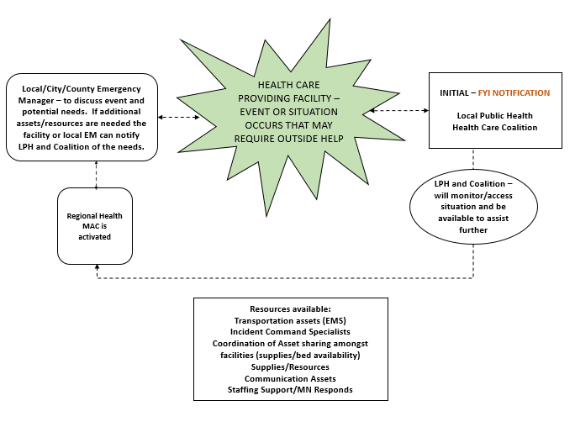
Local/Regional Communications

Slide 4
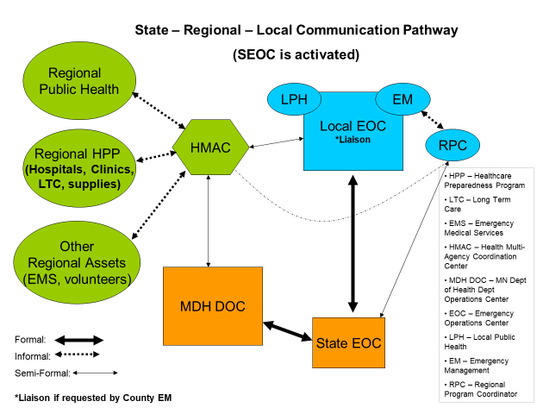

Slide 5
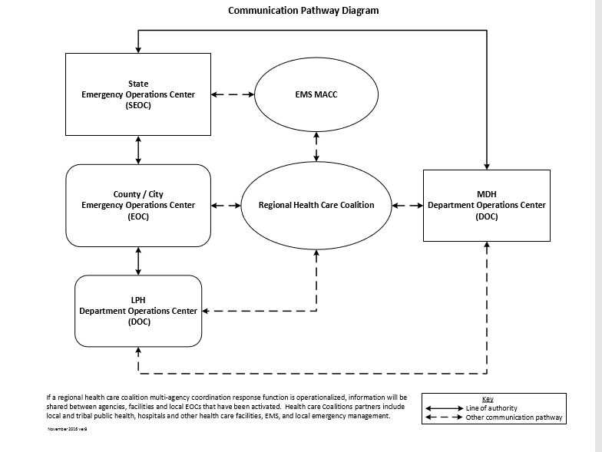
Communication pathways

Slide 6
Assumptions
The following slides will present some scenarios:
Assume that the facility has exhausted their vendors/suppliers
Assume that the facility has already contacted other facilities in the region utilizing the regional MOU
There may be more than ONE right answer
This is an opportunity to discuss ‘what you would do’

Slide 7
Your facility needs potable water to conduct business :
Question 1
The MDH Department Operations Center
C. Your Local Public Health Department
Your Health MAC
D. Your Jurisdiction’s Emergency Operations Center
ANSWER: D – If the EOC is not open then contact your local EM

Slide 8
Your hospital needs sterile water to provide patient care:
Question 2
The MDH Department Operations Center
C. Your Local Public Health Department
Your Health MAC
D. Your Jurisdiction’s Emergency Operations Center
ANSWER: B – your Health MAC or the RHPC if the MAC is not open

Slide 9
Your hospital needs diesel fuel to run the boilers:
Question 3
The MDH Department Operations Center
C. Your Local Public Health Department
Your Health MAC
D. Your Jurisdiction’s Emergency Operations Center
ANSWER: D – If the EOC is not open then contact your local EM

Slide 10
Your clinic needs additional vaccine for your patients:
Question 4
The MDH Department Operations Center
C. Your Local Public Health Department
Your Health MAC
D. Your Jurisdiction’s Emergency Operations Center
ANSWER: C – your local Public Health Department

Slide 11
Your Long Term Care Facility needs N-95 respirators for your staff:
Question 5
The MDH Department Operations Center
C. Your Local Public Health Department
Your Health MAC
D. Your Jurisdiction’s Emergency Operations Center
ANSWER: B – your Health MAC or the RHPC if the MAC is not open

Slide 12
Your Facility needs additional RNs to fill your expanded schedule:
Question 6
The MDH Department Operations Center
C. Your Local Public Health Department
Your Health MAC
D. Your Jurisdiction’s Emergency Operations Center
ANSWER: C – your local Public Health Department
Notes:
Coordination with Minnesota Responds happens at the local level……this question may be confusing because the coalition has agreements amongst its members to share resources so……facilities could contact each other first or ask the MAC to help facilitate the discussions.

Slide 13
Your Facility needs culture swabs for lab specimens:
Question 7
The MDH Department Operations Center
C. Your Local Public Health Department
Your Health MAC
D. Your Jurisdiction’s Emergency Operations Center
ANSWER: B – your Health MAC or the RHPC if the MAC is not open

Slide 14
Your hospital needs transportation for several patients:
Question 8
The MDH Department Operations Center
C. Your Local Public Health Department
Your Health MAC
D. Your Jurisdiction’s Emergency Operations Center
ANSWER: D – If the EOC is not open then contact your local EM

Slide 15
Your facility needs liquid oxygen refill to provide patient care:
Question 9
The MDH Department Operations Center
C. Your Local Public Health Department
Your Health MAC
D. Your Jurisdiction’s Emergency Operations Center
ANSWER: D – If the EOC is not open then contact your local EM

