Slide 1
WCMHPC Sustainability Survey Review
Shawn E Stoen, RHPC
10 January 2020

Slide 2
Survey Summary
Sent to:
Hospitals
Long Term Care
Assisted Living
Home Health
Local Public Health
EMS
Emergency Management
Regional Partners
41 responses collected
Two surveys – one for general awareness and the second for executive leadership
General awareness – 11 questions
Executive leadership – 5 questions

Slide 3
Goals of the survey
To identify and discuss the core functions of the health care coalition
To identify areas that are essential for the coalition to maintain
To identify / focus efforts of sustainability towards the essential functions identified in the survey
To engage executive leadership and support facility representatives in their emergency preparedness efforts.

Slide 4
General Survey Results

Slide 5
Organization Type

Slide 6
What is the role of the person completing the survey?
Notes:
Other included: Quality/Stroke/Trauma Program Manager, Quality Director, EP Coordinator, HICH (?)
Executive leadership were automatically directed to their specific questions.

Slide 7
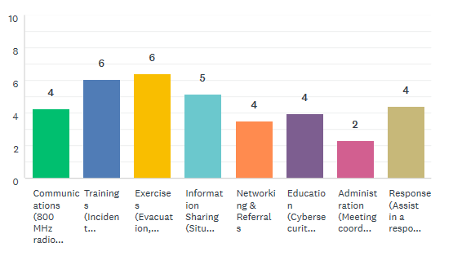
Ranking of services/coordination provided by the health care coalition:
Exercises – evacuation, surge, active threat ect.
Trainings – incident command, decon
Information sharing – situational awareness
Communications – 800 mhz, website, email, Mntrac
Response – assist in response during and event
Education – CMS updates, access and functional needs, cybersecurity
Networking and Referrals
Administration – meeting coordination, facilitation, budget/finance, and staff

Slide 8
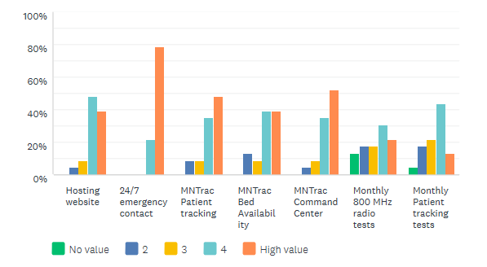
Communications
Do we continue the items listed as no value or do we decrease the amount?
If we decrease – how do we maintain awareness and ensure response during an event?
Notes:
Comments:
Consider decrease the amount of patients in the monthly patient tracking exercise to 5 instead of 10
Home Health and Hospice – MNTrac serves little purpose as we have not been given access to MNTrac (despite requests) and info is not shared
MNTrac will be more valuable as time goes on and more features are utilized daily/prn

Slide 9
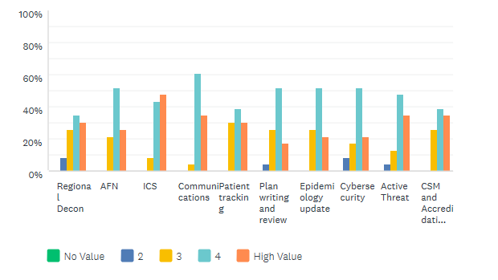
Trainings/Education
Highest ranked:
ICS
Communications
Active threat
CSM and Accreditation updates
Access and Functional Needs
Patient trackiing
Notes:
All trainings and exercises should be done in conjunction with county emergency management (how is this accomplished?)
Cooperate IT masters Cyber threats

Slide 10
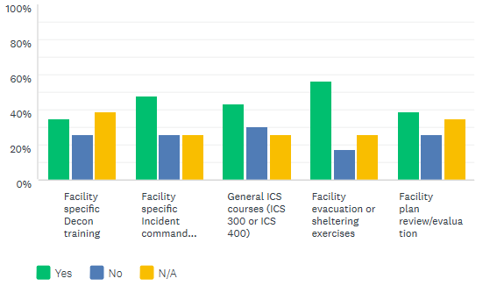
Facility specific activities and willingness to pay for these specific activities
Comments:
PH Staff would need adequate training for sheltering if asked to help with shelters
There is likely no budget for this unless it is mandatory
It would be up to the CEO
It would depend on the costs involved

Slide 11
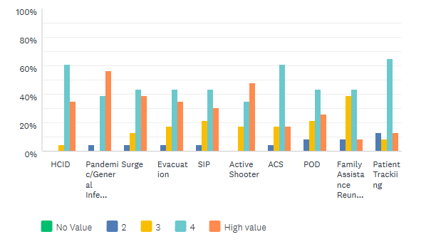
Exercises
What types of exercises would be of benefit to ALL coalition members?
LTC/Hospice/Home Health and Assisted Living
Public Health
EMS
Hospitals
Emergency Management
Notes:
Comments: All are potential events in the region

Slide 12
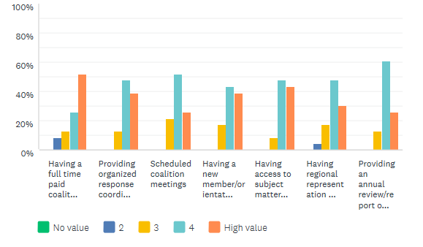
Administration
Having a full time paid coalition leader
Providing organized response coordination to support and enhance response efforts across coalition partners
Scheduled coalition meetings
Having a new member/orientation process
Having Access to subject matter expertise across regional/state and federal levels
Having regional representation and access to statewide response teams (CISM, MNMMT, IMT)
Providing an annual review/report of coalition activites for executive leadership and EP members
Notes:
Comments:
IF PH would be asked to help healthcare respond, having a well functioning coalition is important. We would want this in place and running smoothly.
State response teams could be activated by state duty officer?
Currently Home Health and Hospice get put with LTC when doing planning meetings. Our coalition leader does not see the difference. This makes it challenging for many things to actually be of value for us.
An orientation for people new to EM & the coalition would be fantastic, and also might be valuable for review for current members

Slide 13
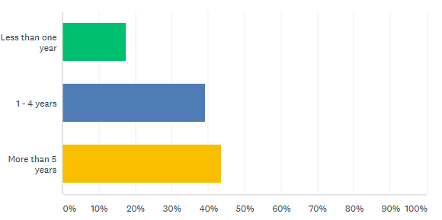
How long have you been an active member of the coalition?

Slide 14
Barriers to engagement with the coalition?
Notes:
Options:
Topics addressed are not beneficial or applicable to me or my organization (3)
My time is prioritized for other work duties (11)
My facility does not support attendance/participation in activities (3)
Nothing – I am engaged as I can be (10)
Other:
Time to complete items from follow up notes from meetings can be limited
Looking forward to being more engaged in 2020
Webinar would be beneficial
Our coalition leader does not distinguish home health and hospice but puts us with LTC which is not beneficial
I still work off hour shifts. Facility tries to schedule me to allow me to attend meetings and trainings but it isn’t always possible
It would be helpful to have more participant engagement at meetings

Slide 15
Executive Leadership questions

Slide 16
How familiar are you with the role and services of the HCC

Slide 17
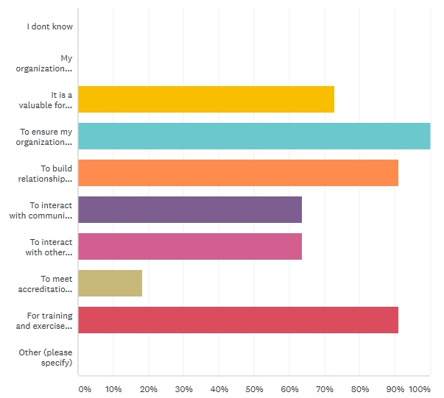
Why does your organization affiliate with the coalition?
It is a valuable forum for shring information and best practices
To ensure my organization is prepared in the event of an emergency
To build relationships with other partners who might be able to help me during an emergency
To interact with community partners
To interact with other leaders
To meet accreditation requirements
For training and exercise opportunities

Slide 18
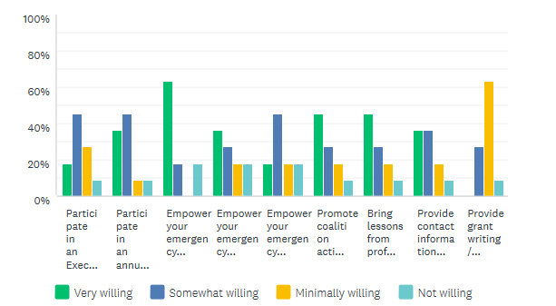
How willing would you be to:
Participate in an Executive Leadership subgroup/meeting periodically.
Participate in an annual call or report on coalition activities.
Empower your emergency preparedness representative to support the coalition’s administrative tasks.
Empower your emergency preparedness representative to volunteer their time for coalition deliverables and work products.
Empower your emergency preparedness representative to volunteer their time for a response that supports other healthcare organization(s).
Promote coalition activities with state, regional, and local professional groups and /or societies.
Bring lessons from professional groups or societies back to the coalition.
Provide contact information for vendors that could support the coalition.
Provide grant writing / application assistance

Slide 19
How willing would your organization be to financially support the coalition by:
Notes:
I would need to see the specifics of what the dues went toward. Much of our EP time is county funded already. (PH LEADERSHIP)
At a reasonable rate.

Slide 20
Next steps?
Continue to identify alternate funding sources/grants
Continue to engage membership
Create a draft sustainability plan to identify the priorities of the WCMHPC

Slide 21
I AM TIRED!!!!!
Questions?
This Photo by Unknown Author is licensed under CC BY-NC

