Slide 1
WCMHPC LTC Incident Command Training
OPERATIONS SECTION
Shawn E Stoen,
Regional Readiness and Response Coordinator

Slide 2
Objectives
Review the roles/responsibilities of the Operations Section
Discuss the positions within the Operations Section
Review the ICS forms utilized by Operations

Slide 3
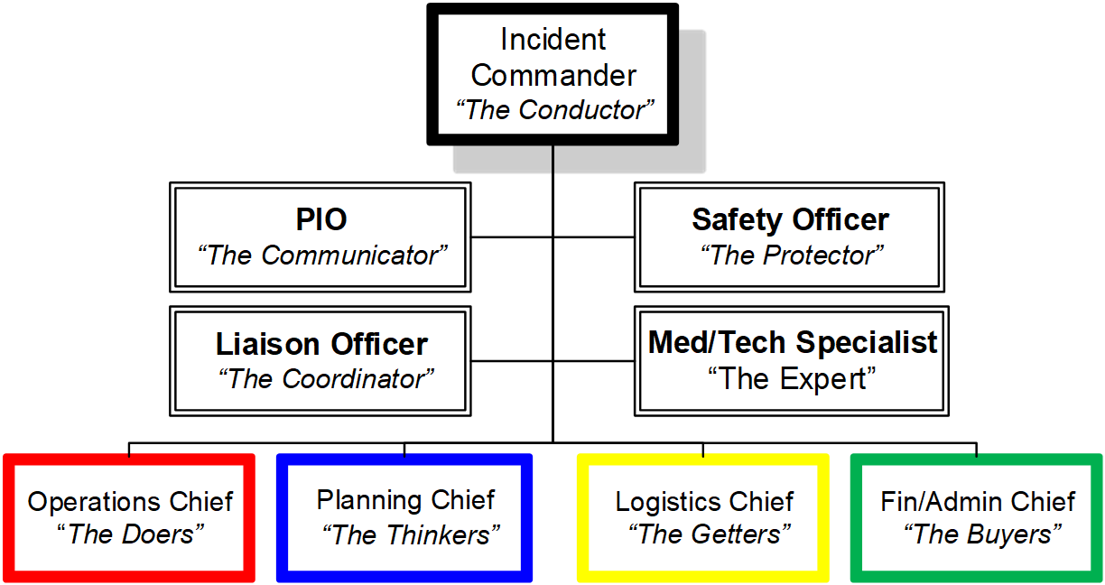
INCIDENT COMMAND OVERVIEW
Command Staff
General Staff
Notes:
The Operations Section – these are the workers – they are the ones doing the patient care, the maintenance, the basic operations of the facility. They are essential to the facilities whole response and recovery capabilities. The conduct the tactical operations and are tasked with completing the objectives set out by the incident commander.

Slide 4
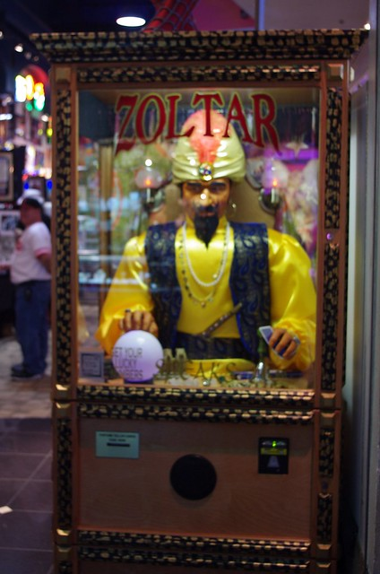
Operations Section Chief
Who is the ideal person to fulfill this role?
The individual needs to have foresight
Multitasker
Communicator
Educator
This Photo by Unknown Author is licensed under CC BY
Notes:
Who is the Operations Section Chief is dependent upon the situation. If the main ‘issue’ is structural damage and the main objectives are to repair the damage then the focus is on facilities not residents. It is important that the IC decide who is the best person.
This person needs to be able to have the vision to look to the future to determine the best response.
They can not be overwhelmed easily as they will have to juggle multiple objectives
They need to be able to discuss their ideas/objectives and provide direction to their section chiefs

Slide 5
Operations Section Chief
Responsibilities:
Determine what needs to be done to complete the objectives
Works with Planning and Command to identify incident objectives and create the incident action plan
Assign individuals to control and complete the tasks
Identify what resource types are needed
Work with the command staff
Share information
Have a scribe record all activities/decisions/requests (complete the Activity Log ICS 214)
Works closely with the facilities Medical Director for critical decisions/response suggestions/medical orders
Notes:
Remember the operations section chief is working for the future not the now………….
They assign people to do the work while the chief is busy identifying what are the needs to ensure that the work CAN be done.

Slide 6
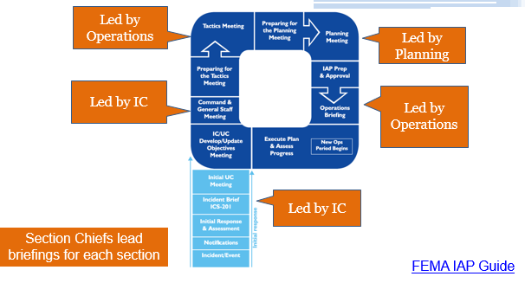
Briefings/Planning P
Purpose: To convert objectives into tactics.
Determine how objectives will be accomplished
Deconflict resource requests and assign resources
Identify methods for monitoring tactics and resources
Identify all tactics and resources from all branches – not just Operations
Notes:
We will get more into the Planning P and Briefings in January

Slide 7
Operations Section Chief tools
Operations Section Chief Job Action Sheet
Remember to delegate
Maintain Span of control
Facility Operations plans

Slide 8
SPAN OF CONTROL
What specific facility roles would fall under Operations?
Notes:
Dietary
Maintenance
Housekeeping
Patient care – Nursing
Physical therapy
Admissions

Slide 9
Operations Section Org Chart
Operations Section Chief
Resident Services Branch Director
Infrastructure Branch Director
Notes:
This is the busiest section. It is ESSENTIAL that duties are assigned and span of control is maintained.
What is SPAN of Control?
So lets talk about who does what as we look deeper into the Operations Section……………..

Slide 10
Resident Services Branch director
The care of the residents is the TOP priority
Identifies what resources are needed to ensure proper care
Dietary
Medications
Medical treatments
Durable Medical equipment needs
Resident tracking (admissions/evacuations)
Triage and treatment

Slide 11
Resident Services Branch breakdown
What Units could be created to help with Span of Control?
Dietary – prepare/serve food
Nursing
Transportation
Admissions

Slide 12
Resident Services branch tools
Resident Services branch director job action sheet
ICS 214 Activity Log
ICS 254 or 255 Patient tracking (admissions/evacuations)
IC 260 Individual resident information
Facility emergency operations plans
Incident Response guides
Notes:
Will talk about the IRG’s

Slide 13
Infrastructure Branch Director
Works closely with a Safety Officer (if assigned)
Areas of concern:
Facility heating/cooling systems
Electrical operations
Facility infrastructure – damage assessment/repair
Sanitation/housekeeping
Dietary
Water (potable and non-potable)
Food storage/capacity
Communications
Facility access (parking lot)
Security

Slide 14
Infrastructure Branch break down
What Units can this be broken down to?
Engineering
Sanitation
Maintenance
Dietary
Security

Slide 15
Infrastructure branch tools
IC 214 Activity log
IC 251 Facility System Status Report

Slide 16
Incident Response Guides
Provides a checklist for activities to consider
Breaks down the roles and responsibilities of each command and general staff position
Provides suggested objectives for the response

Slide 17
Demobilization
Plan for demobilization at the onset of the incident
Goal is to get be to pre-event status as soon as possible

Slide 18
QUESTIONS/DISCUSSION
Next training – Logistics/Finance (December 18, 2019)

