Slide 1
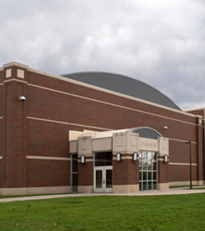

Closed Point of Dispensing Training
Preparing your organization to provide emergency measures for your staff, their family and potentially clients
Notes:
Welcome! We’re going to be learning about how your organization will function as a Closed Point of Dispensing today. Which when it comes why you want to be a CPOD is to take care of your staff, their families, clients and hopefully also be able to carry on some of your normal operations during a public health emergency.

Slide 2
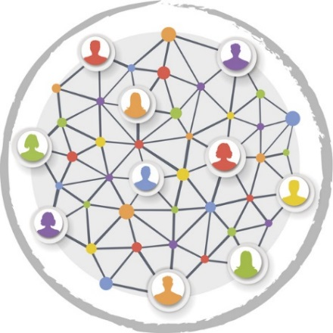
Purpose
To provide background information and context for roles in providing medical countermeasures (MCMs) through Closed Point of Dispensing (CPOD) sites during an emergency.
Notes:
This CPOD Training introduces the concept of a CPOD, its activation and how it functions to provide the MCMs to people.

Slide 3
Learning Objectives
  Outline the decision process for activating point of dispensing (POD) sites during a public health emergency
  Define a POD and a Closed POD
  Explain the importance of any POD during a public health emergency
  Describe the CPOD functions and roles
Notes:
We should be able to describe how the decision is made to activate PODs during a public health emergency, describe a point of dispensing (POD) site and CPOD, explain its importance during a public health emergency, and describe what the functions and roles a CPOD entails.

Slide 4
It All Starts Somewhere
Incidents begin and end locally
Notes:
At the onset of the incident, local parties assess the situation and determine the appropriate response. Based on the size and complexity of the incident, other jurisdictions and organizations may become involved. Regardless of the number of response partners, prophylaxis or treatment against disease, always occurs at the local level.

Slide 5
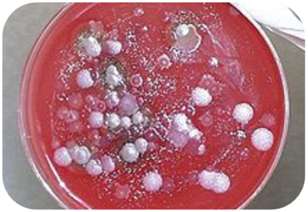

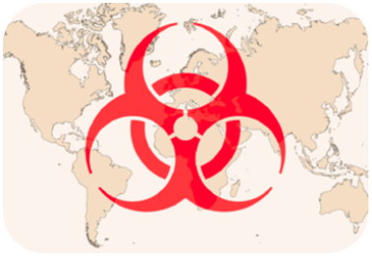
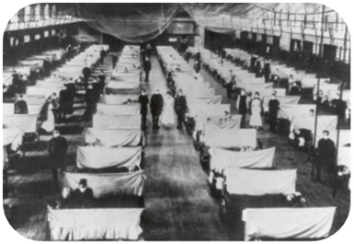
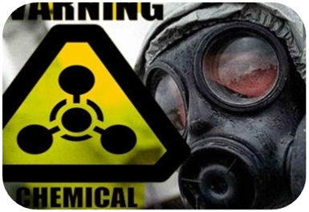
Public Health Threats Trigger PODs
Emerging Infectious Disease Biological Agents
Pandemic Influenza Environmental Health Hazard
Notes:
PODs may be activated in the event of an intentional or accidental release of a chemical agent or other public health threat. These threats could potentially trigger the activation of different ways to provide MCMs to the public because smallpox, plague, anthrax and influenza can result in high death rates.
Currently, the Minnesota Department of Health has a protocol to provide MCMs for an anthrax exposure. This protocol contains all authority, documents and information for someone to provide medication. It includes screening forms, education, labels, guidance, the whole works.
Some materials are available in other languages and you can work with you LPH to see if what you need is available.

Slide 6
Who Decides?
POD activation could be a local or state decision
Assessment includes:
  Threat
  Needs
  Local resources
Notes:
Once the threat has been identified, state or local partners will decide if they will open a PODs or not. During the decision process, an assessment of threat, needs, and local resources are conducted.
If local response resources are sufficient, the process of coordinating state, regional and local partners and services will begin.

Slide 7
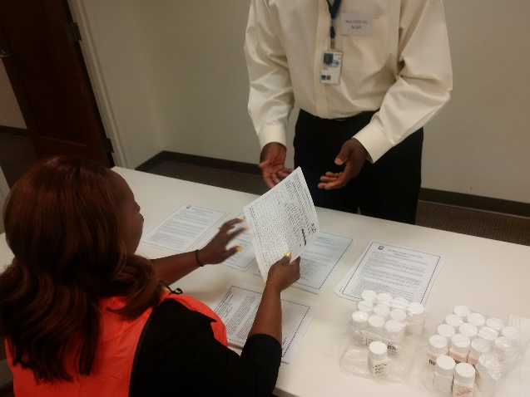
POD Definition
A POD site is a pre-identified site where Medical Countermeasures (MCMs) are given to people to minimize the effects of a public health threat or emergency.
Notes:
A POD is a fixed, pre-identified public site at which MCMs are given to people to minimize the effects of a public health threat or emergency. MCMs may include pills, or shots, which are a “measure” or intervention designed to “counter” whatever illness or health threat that may impact the public. It’s given as a prophylaxis to prevent illness.
Although PODs have a medical component to them, they differ from medical treatment usually received during a non-emergency situation. So, let’s discuss what a POD is and is not.

Slide 8
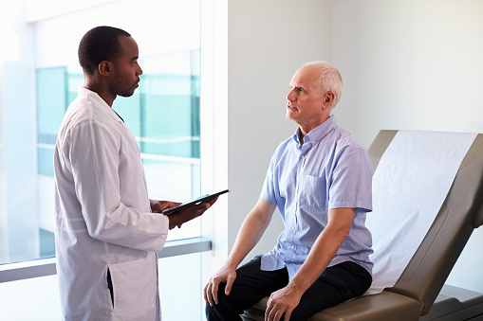
A POD is NOT… 4
a medical clinic to treat sick individuals
set-up like a typical doctor’s office
staffed strictly by medical professionals
designed to provide in-depth or individualized consultation services
Notes:
A POD is not a medical clinic that treats people who are sick. It is a dispensing site that is designed to provide medications or shots to healthy individuals to prevent them from getting sick. Public information campaigns and or messages will direct sick individuals to a different treatment location.
A POD does not resemble typical clinical operations where an individual is seen by a doctor in a private exam room. They are typically in an open space to allow a large flow of people to pass through.
PODs will be staffed by public health staff, possibly volunteers or employees of the CPOD site. We want our medical staff to concentrate on medical care.
This is not a typical individual care. Think of it as a “fast food” type of care where you get assigned a value meal depending on how you complete the order form. This is to be quick and overarching. Those needing more consultation will be identified and handled appropriately.
Now let’s discuss what a POD is.

Slide 9
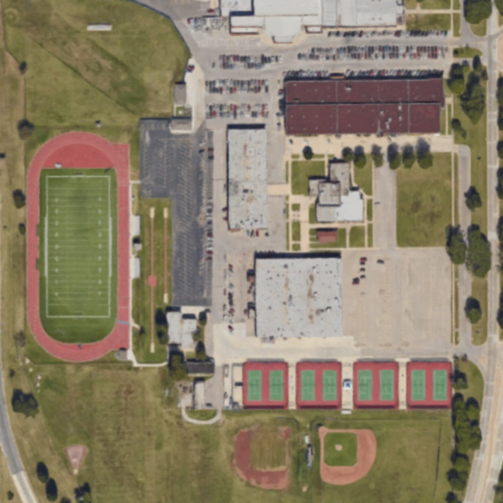
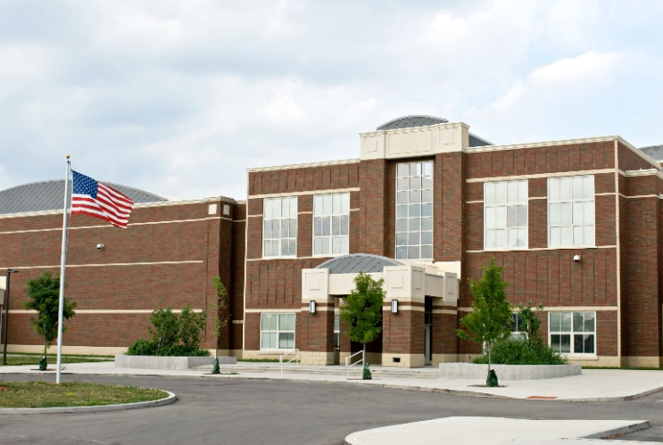
A POD is… 1
established in a non-traditional setting
POD
Notes:
PODs are not in locations typically used in a medical setting. Instead, POD locations are usually public facilities that are familiar to the community and can include:
Schools
Community Centers
Arenas
Designated spots are done by Partnership 4 Health Public Health agencies in Wilkin, Clay, Becker and Otter Tail Counites.
Horizon Public Health has locations in Morris, Alexandria and Glenwood to reach their counties of Stevens, Traverse, Grant, Pope and Douglas.

Slide 10
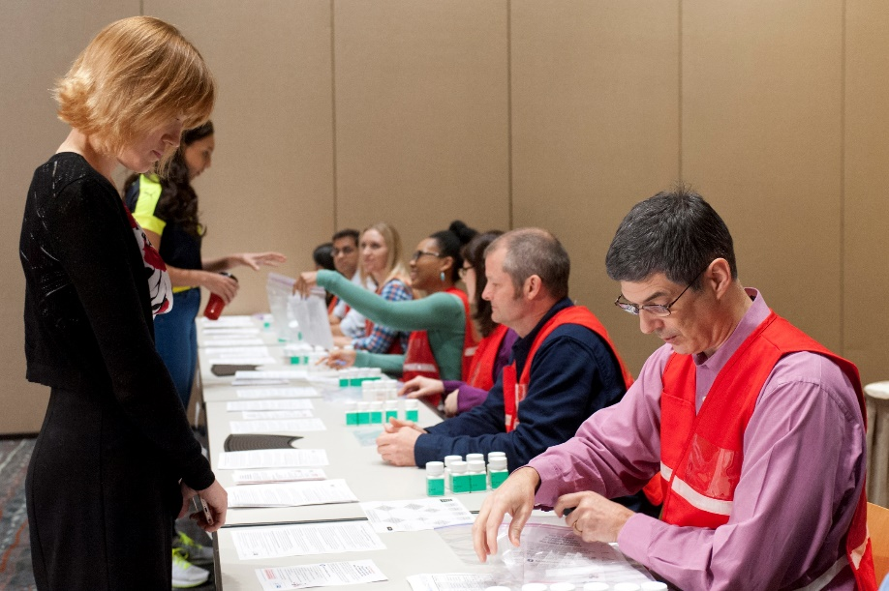
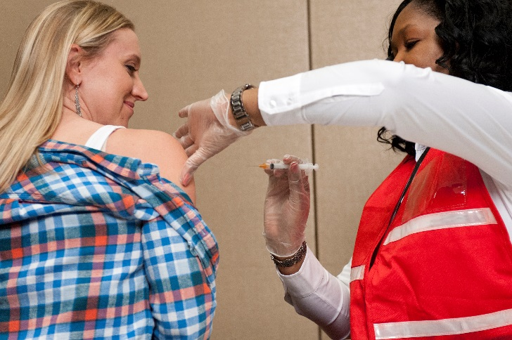
A POD is… 2
established in a non-traditional setting
where healthy individuals receive medications or vaccinations
Notes:
During a public health emergency, we want healthy individuals to come to a POD to receive medications or vaccinations. We do not want sick individuals at the POD because of the potential to infect healthy individuals.
Inevitably sick individuals may show up at a POD, but triage is in place at the POD to detect those sick individuals and move them out of the main POD process.

Slide 11
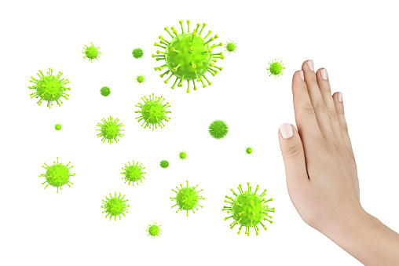
A POD is… 3
established in a non-traditional setting
where healthy individuals receive medications or vaccinations
a place that prevents individuals from getting sick
Notes:
Identifying the source of the public health threat and the specific individuals who were exposed can take time. PODs are a preventative measure that provide the initial medication dosage or vaccination to everyone in a potentially affected area. Once the source of the public health threat is identified, additional medical treatment will be provided to exposed individuals.
In the meantime, we want to cast a wide next of prophylaxis medication to prevent illness and potentially death.

Slide 12
Time is Critical
To decrease number of those who get ill or die
Survival Rate (before symptoms)
Survival Rate (after showing symptoms)
Why Rush?-
Notes:
PODs are considered the cornerstone of a MCM response especially for threats that have high death rates and where a quick response is critical, such as in response to a release of anthrax. By quickly providing MCMs to anyone who was potentially affected the likelihood he/she becomes ill or dies decreases.
Partnership 4 Health would be responsible for 162,400 people and Horizon Public Health has 67,500 people. These are base populations and don’t take into account people visiting the area. All would need MCM within two to three days. This is a challenge. But if a person is exposed to a deadly biological agent such as anthrax, plague, or tularemia, he or she has a much better chance of survival by taking MCMs before becoming symptomatic. Persons exposed to anthrax can become fatally ill in as short a time span as 48 hours without prophylactic antibiotics. Time is critical so opening CPODs reaches people faster.
CPOD help reduce the amount of people that will go to an open POD site and help get MCM to those persons faster.
You may see the terms POD and CPOD used fluidly in this remaining information. That is because the functions, staff positions and MCM are the same for an open POD for the public and your CPOD. Just remember that your CPOD only provides MCM to its designated population, not the general public.

Slide 13

Closed PODs
Organization dispenses to their own population
Not open for the public
Partners with LPH to develop scope and plan
Organization staffs CPOD internally
MCM are free
Notes:
A Closed POD is designed for a partner to receive MCM from LPH and dispense these to their own specific populations. They are NOT open to the public. These organizations will only dispense to their staff, clients or other identified people. LPH works with CPOD sites to develop their plans. The CPOD provides its own staff to run the CPOD. Technical assistance for running a CPOD will be provided as needed. The MCM provided are still free to the organization and people receiving them as they come from the SNS.
Your organization is receiving this training today as you are an identified CPOD site.

Slide 14
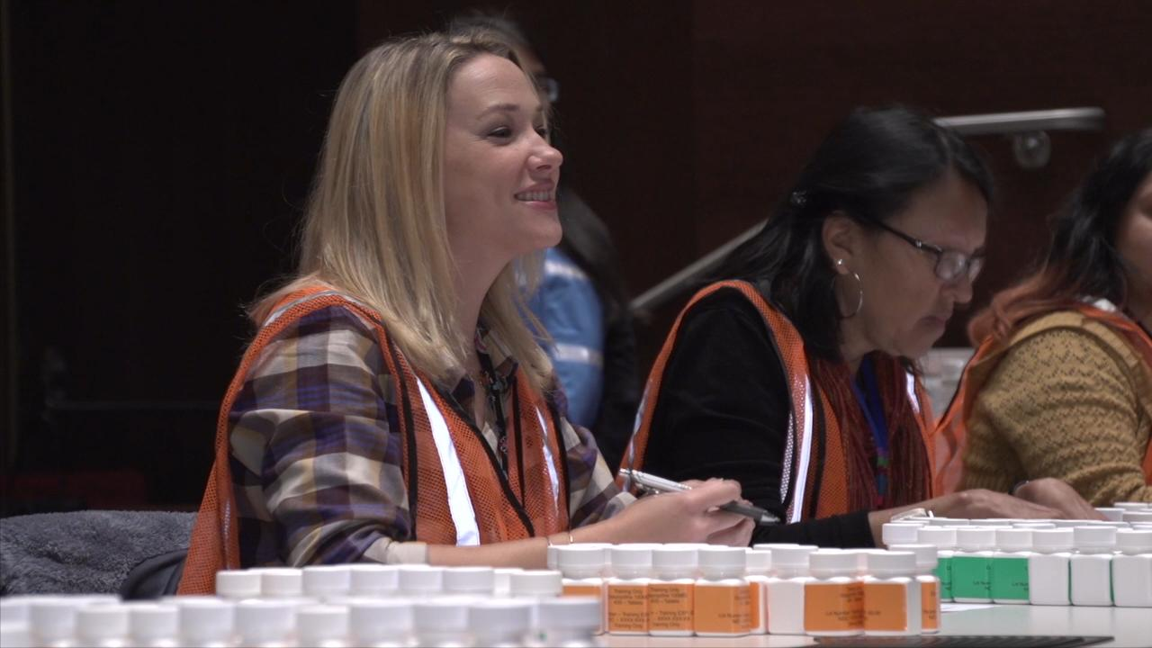
CPOD Operations Depend on You!
CPOD staff come from within the organization
Efficient operation requires proper training
Technical support will be provided by LPH
Notes:
During a public health emergency, your organization will provide the staff needed to run the CPOD. LPH will provide plans, tools and training to help you do this. You will need to follow the MDH protocol to dispense the provided MCM.
When thinking of CPODs, these functions are filled by the staff. If your organization is a CPOD, think in terms of what employees would fulfill these roles.

Slide 15

CPOD Staff Activation and Orientation
Receive activation notification
Check-in at CPOD location
Receive just-in-time-training
Perform work assignment
Check-out of CPOD
Notes:
Now that it has been established your CPOD is opening, let’s talk about what a CPOD worker would experience in this situation. You would receive notification that you are needed to help with CPOD operations. The notification will include reporting details so you know where and when to show up. Once you arrive at the location, you’ll need to complete the check-in procedures to let CPOD staff know you arrived and to receive your work assignment. Before beginning your first shift, you will receive a Job Action Sheet and will receive just-in-time-training for your station area to help you with the specifics of your work assignment. After your training, you will be ready to perform your work assignment for the designated shift duration and you will walk through CPOD and receive medications. Once your shift is over, you need to complete CPOD check-out procedures.

Slide 16

Notification of CPOD Staff
Where to go
  Facility
  Room
When to report
  Immediate
  Standby
What to bring
  Photo ID or Badge
  Wear comfortable clothes and shoes
Length of time
  Duration of CPOD operations
  8, 10, 12 hour shifts
Notes:
You should receive information on where to go, when to report, what to bring, and how long you will be there. This information is incident specific.

Slide 17

Check-in Procedures
Report to sign-in area
Obtain work assignment with Job Action Sheet
Participate in CPOD general briefing
Receive MCMs
Notes:
When you get to the CPOD, report to the designated staff sign-in area. You will receive your work assignment. You will receive medical countermeasures for yourself and individuals. This may be before or after your shift, depending on how your organization decides to do that.
A general briefing includes: incident specific information, overview of CPOD process, a facility orientation, addresses the goal of the CPOD and other necessary information.

Slide 18
Training of CPOD Staff
Just-in-Time Training is about the job you are about to start
  Delivered before your shift
  Outlines the CPOD process - stations
  Identifies resources – materials, equipment and supplies
Notes:
Just-in-Time Training is provided when it is actually needed. You will see where your specific work assignment fits into the overall CPOD process. Any materials, equipment, or supplies used to perform your work assignment will be identified and explained during this training.

Slide 19
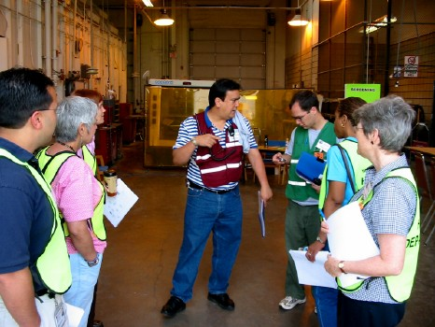
Training of CPOD Staff (Cont.)
Training on your assigned
work areas/tasks
  Job Action Sheets
Identifies leadership structure or chain of command
  Who to report to
  Who may report to you (if applicable)
Notes:
Training includes specifics on tasks or duties that you must complete during your shift. Job action sheets are distributed to staff as a tool or resource that can be used while they are working. A job action sheet is a guide for you POD job.
ICS chain of command will be provided. This identifies the individual to whom you should report. If you are in a leadership position, this includes who may report to you.

Slide 20
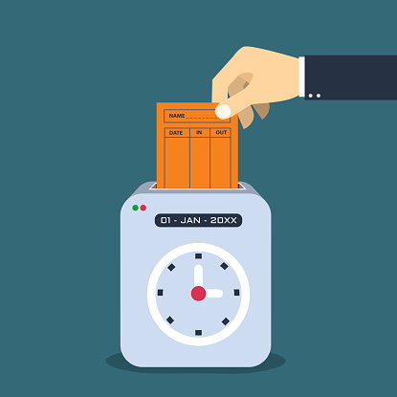
Checkout Procedures
Just-in-time training for next shift
Restocking workstation (as needed)
Reporting requirements fulfilled (if any)
Debriefing
Sign out
Notes:
Once you have completed your shift, you should complete the designated checkout procedures at the CPOD.
You may be asked to conduct just-in-time-training for the next shift that will take over your work area. Doing this ensures that the next shift of CPOD staff are able to pick up working where you left off.
Next, you may be required to restock any supplies at your workstation so that the next shift will be adequately prepared to begin working.
You may be required to fulfill certain reporting requirements upon completion of your shift. An example of this could include turning in forms that include the number of vaccinations administered or medications dispensed during your shift. Another example might include reporting the number of hours worked.
You will participate in a debriefing before leaving.
Last, you should sign out of the CPOD so that other staff know you have left and you can be accounted for. When signing out, you will need to provide contact information so that CPOD staff can follow up with you on work related items or MCMs you received at the CPOD.

Slide 21
Thus Far……
PODs are activated in response to a public health threat.
PODs are pre-identified locations where people receive MCMs to minimize the threat effects.
PODs provide MCM quickly to threats with potentially high illness or death rates.
CPODs service a specific population and are closed to the public.
POD staff gets activated and trained to work at a POD site.
Notes:
to this point we have talked about . . .
That POD are activated in response to a public health threat, including the biological threats and that surveillance activities occur early in the process and start with the one person who shows up at the hospital.
We talked about all threats starting locally and the work that is done immediately to assess local response resources. If resources are needed they are pulled in from the state then region and then from the federal government.
PODs are pre-identified sites where people receive MCMs to minimize the effects of a public health threat.
Closed PODs serve those within that CPOD site only and are not open to the public.
PODs are the cornerstone of a MCM response especially for threats with potentially high death rates where a quick response is critical, such as in a release of anthrax
Finally, we talked about what POD staff activation includes - receiving reporting details, check-in at the POD, getting trained and completing check-out procedures after your shift.
As a reminder, you may see POD or CPOD on the slides or hear it when I talk. Your organization is a Closed POD so remember that throughout.

Slide 22
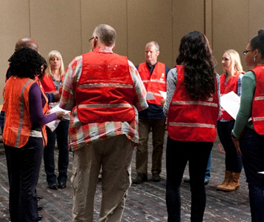

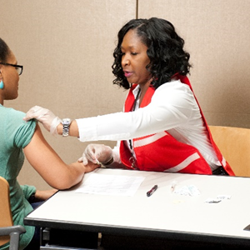
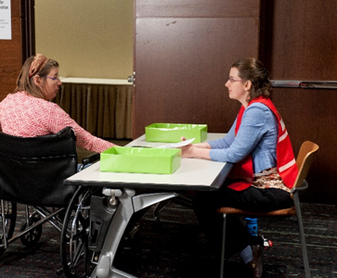
CPOD
Functions Overview
Notes:
Now that we have defined a CPOD and explained staff orientation and activation, let’s talk about the main CPOD functions to operate a POD site during a public health emergency.

Slide 23
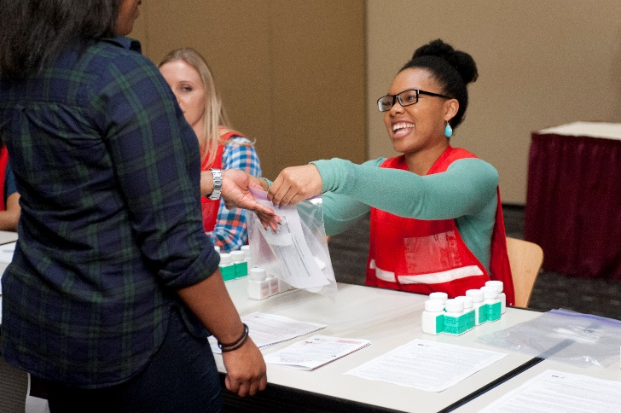
Main Functions of a CPOD
Greet/Triage
Registration
Forms Review
Screening
Dispensing
Education
Exit Usher
Notes:
As we discussed in the overview, CPODs are pre-identified locations where the public will go to pick up or receive MCMs during a public health emergency for themselves and, in many cases, their family members.
As referenced in the slide, these are the main functions of a CPOD. These functions are needed, but one person be doing multiple parts of this process for a small agency.

Slide 24
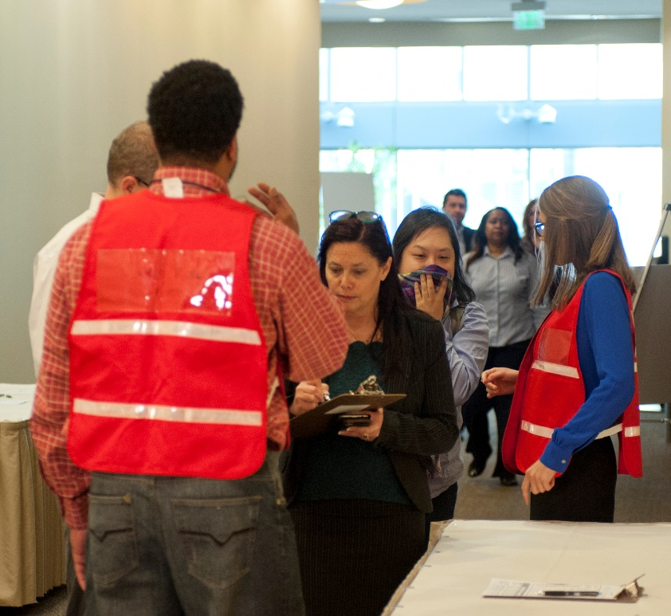
Greet/Triage
CPOD clients are essential “pre-sorted”
Triage for symptoms, divert people as necessary
Provide clients a screening form
Direct to registration
Notes:
Greeter/Triage will greet and triage individuals when they arrive. This may require answering client questions. They direct individuals to registration-the next appropriate area within the POD.

Slide 25
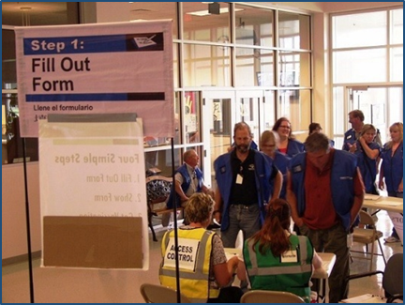
Registration and Forms Review
Be familiar with the screening form
Provide form and help clients complete it as necessary
Have available clipboards, pens, chairs if appropriate
Direct client to forms reviewer who directs
client to a screener or back to registration
POD PreCheck available
Notes:
Registration and forms is about the paperwork. There are paper forms available and you will need space and supplies to have people complete these, unless you are having them bring a completed form.
The PreCheck is an option as well. They can either complete at the CPOD site or bring the printed results from the PreCheck.

Slide 26
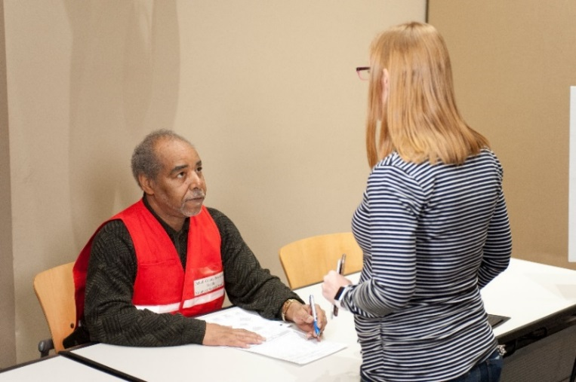
Screening
Use the algorithm to determine which MCM is to be given…or not
Document appropriate MCM on the form
Direct client to:
    Dispensing
    Medical consult
Notes:
The screening station typically requires POD staff to determine which MCM if any, should be given by reviewing a screening form. Once the MCM determination has been made, the screener will direct the client to the dispensing station or to medical consult.
If the person has a PreCheck Form, this is already figured out and it will say what type of MCM to dispense.

Slide 27
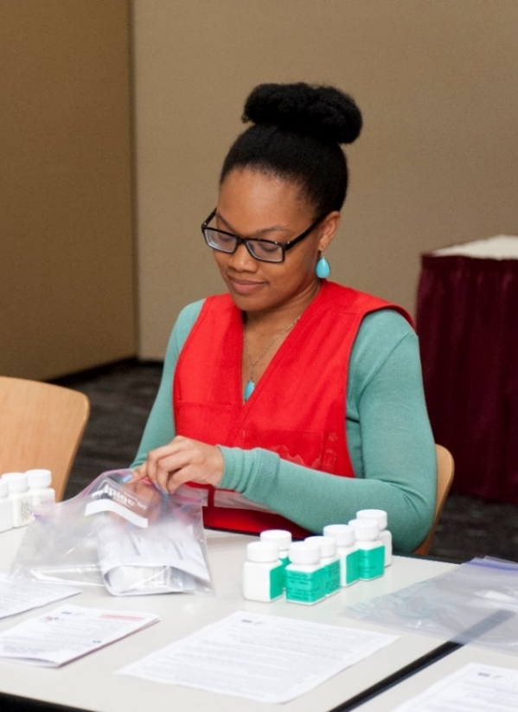
Dispensing
Check for MCM determined by screener
Give client:
  Labeled MCMs
  MCMs fact sheet
  Collect screening form
Direct clients with questions to the education
Direct clients with no questions to exit
Notes:
Dispensing provides the correct MCM, labels them and gives the corresponding medication fact sheets. This can be combined with the screening function. Sometimes you may feel more comfortable with a team of 2 people doing this role to double check each other. Screening forms are to be collected at this point.
Clients are then directed to further education if needed or the exit usher once they receive their medication. The exit usher and educator may even be the same person!
Just a reminder, that this is focused on pill dispensing, not vaccination. That process is similar, yet different.

Slide 28

Education and Exit
Answer questions about how to take medication
When to visit health care provider
Take the first dose as soon as possible
Exit the CPOD
Notes:
The education station provides information and asks if all questions are answered. The client can then be directed to the exit usher and exit. Again, in a CPOD or smaller setting the education piece may be added to the screener/dispensers, especially if there is a team approach done.
Once the person has their MCM, they are free to go. Encourage them to take the first dose as soon as possible.

Slide 29
Incident Command System (ICS)
Incident Commander
Command Staff
Public Information Officer
Safety Officer
General Staff
Liaison Officer
Operations Section
Planning Section
Logistics Section
Finance/
Administration Section
Notes:
Each POD has some form of organizational chart. LPH encourages the use of Incident Command System. This is an example organizational chart used during emergencies.
Does anyone remember the “easy language” to help identify the jobs of each of the General Staff? The Doers, Getters, Planners and Payers.

Slide 30
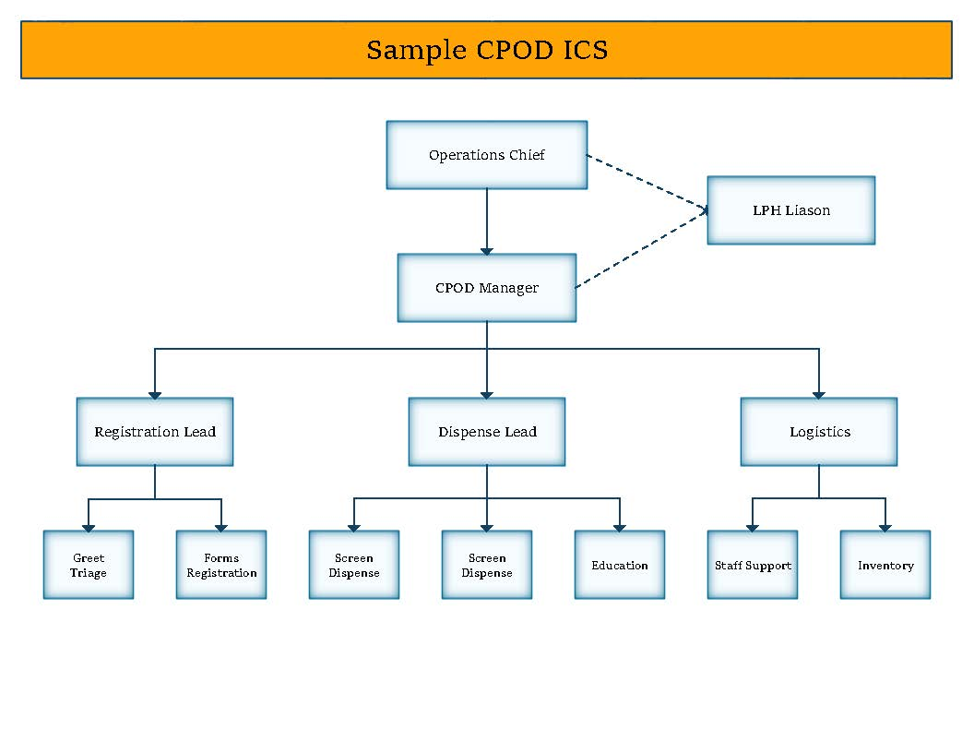
Notes:
This is a sample CPOD organizational chart. The COPD Manager is working under the direction of the Operations Chief from the prior ICS chart. Any type of organizational chart can work for your system, but some type of structure is needed. This lets staff know who to report to for questions as well as define their role within the CPOD.
LPH will work with CPOD regarding their ICS structures. Job names also may be different, depending on planning tools and what already exists in an organization.

Slide 31
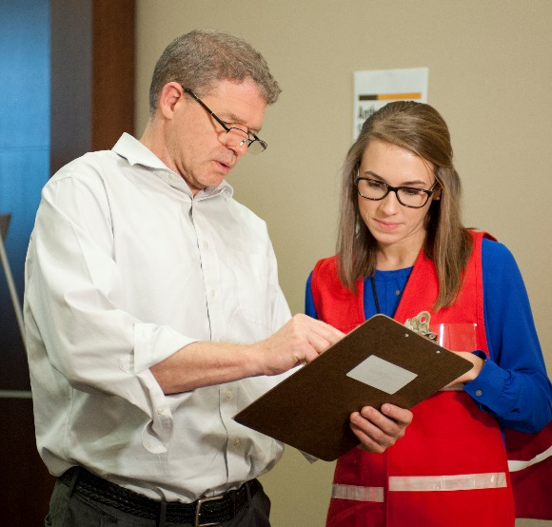

Other CPOD Staff Roles
Supervisor positions
Courier
Functional Needs
Medical Consultant
Inventory/Logistics Manager
Technology Support (IT)
Psychological First Aid
Security Lead
Safety Lead
Notes:
If you have a very large CPOD organization or through planning identify the need for any of these role, LPH will help your site add them to planning measures.
Although with the IT, your best on your own. ☺

Slide 32
Thus far……
The main functions of our CPOD include:
greeting and triage, registration and forms, screening, dispensing and education.
The Incident Command System can be used for management.
There are an array of different roles that support the CPOD functions.
Notes:
In conclusion, we have identified and discussed the main functions of a CPOD…see slide.
Now we’re going to go a little more indepth on how those CPOD functions are done.
.

Slide 33
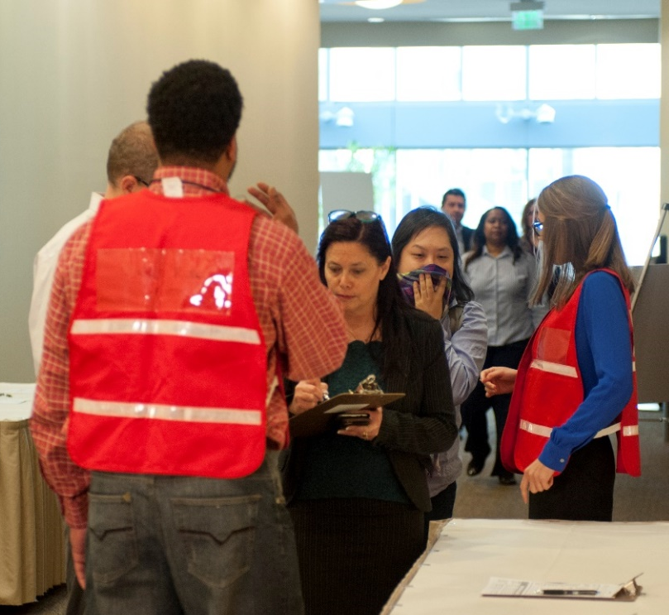
Greeter/Triage Tasks
Identify those served by CPOD and refer others to open POD
Divert symptomatic clients
Direct people who require extra assistance to area
Guide clients to next appropriate CPOD area
Answer general questions about the CPOD
Notes:
Greeters welcome people to the CPOD. As your site is closed to the public, these are your co-workers, their family or your clients. They need to be identifiable in some manner which your planning process has defined. If someone self-presents at your site and isn’t part of your identified population, you will need to direct them to an open POD and have the means to do that. Be careful as to people who may “slip through” screening.
CPOD participants still will need to be triaged. This basically means identifying those who may be symptomatic to health care. You can either quickly dispense to them and sent them to health care or have them directly seek medical attention. We do not want any symptomatic people, especially if the agent is communicable between people, entering a CPOD to possibly infect others.
Here is also where those who may need more assistance with forms or getting MCM will identified and accommodations need to be made within planning for some.
This person also needs to be able to guide them to the next station and answer questions.

Slide 34




Be Alert! Emotions can be high!
Notes:
In the greeting/triage role, you are often the first person clients encounter when they enter a POD. Remember, during a public health emergency people can express a wide range of emotions.
Hopefully, as you are doing this within your organization, there has been good education about the benefits of receiving the MCM to staff. This way they can come more calm, prepared and have their questions ready. You’ll want to remember this for all the CPOD staff as well.

Slide 35
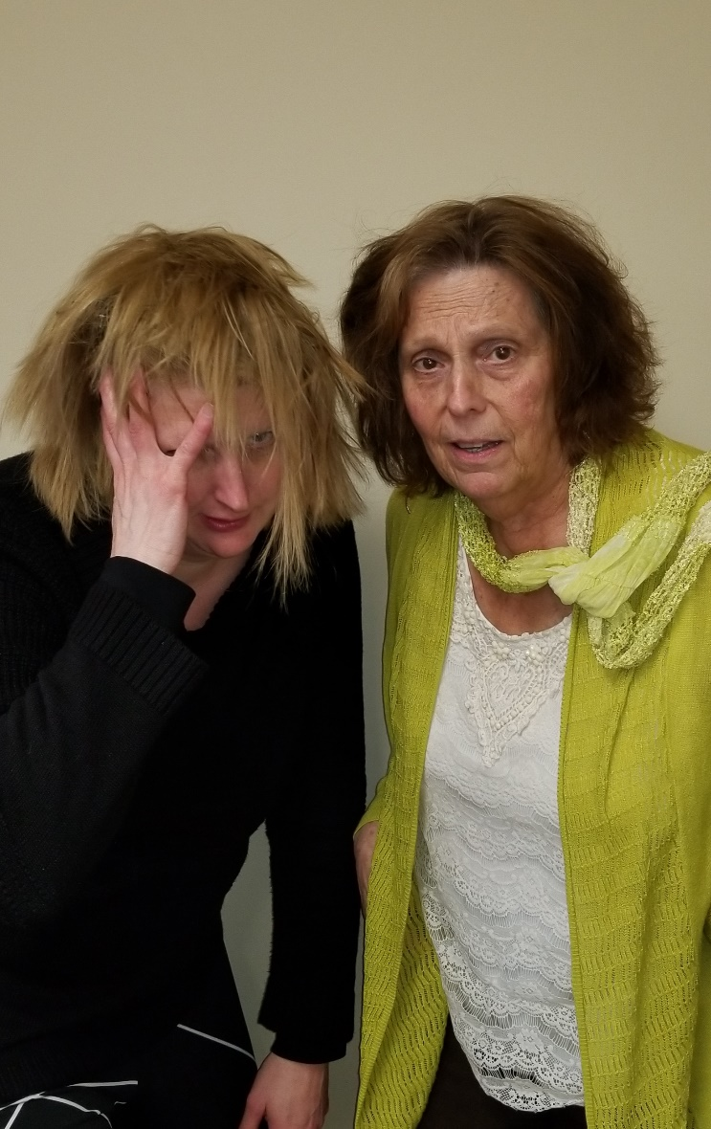
Recognizing and Managing
Stressed Clients
Look for…
  Emotional responses
  Physical indicators
Do…
  Remain calm
  Take a deep breath
  Recognize normal stress responses
  Empathize with clients
  Attempt to diffuse the situation
  If necessary, alert someone and get help
Notes:
IS THIS NECESSARY FOR A CPOD SITE? ALTHOUGH I DO LIKE THE PHOTO OF OUR FRAZZELED FRIENDS….
If you notice an obviously stressed client, what should you do? First and foremost, remember to stay calm. It’s important that you stay focused and in control. Allowing a client’s stress to influence your own emotions or actions will only make the situation worse.
Next recognize the stress response, and do not take it personally. Instead, use the stress indicators to inform how you interact with the client. Be empathetic with the client. Imagine being in their shoes, and show them you care. Attempt to diffuse the situation. Reducing the client’s stress not only helps the client move through the POD faster, but it can help other clients in the POD keep calm.
It’s important to know that you will not always be able to make the client feel better. In these cases, the goal is simply to prevent the situation from becoming any worse. If the client becomes increasingly emotional and starts to affect the security and wellbeing of others in the POD, call the Client and Health Staff Supervisor, POD Manager or security. It is important to remove these individuals to a separate area for psychological first aid so they do not upset or hurt other clients in the POD.

Slide 36
Registration and Forms Review Tasks
Registration
Help clients complete the screening form
Answer questions about the form
If a functional access need is identified, help the client to get proper assistance
Direct clients to Forms Review
Assist with POD PreCheck if available
Forms Review:
Review form to ensure all questions are answered
If not-ask client to complete the questions
Direct client to Screening when the form is complete
Notes:
These are the tasks for Registration and Forms Review. Again, these are often combined roles for one person to do. If the person is bringing in a prefilled form, there still may be questions. People with POD PreCheck forms can be directed once ensured they have completed forms. Those who need medical consult should be directed to the designated person to handle that or directed to contact their health care professional.

Slide 37
Screening Tasks
Confirm important health conditions
Apply the screening algorithm to determine appropriate medication
Determine if medical consultation is necessary
Direct clients to dispensing
Notes:
Screeners look at the form and apply the algorithm to decide which medication is appropriate. There is guidance within the protocols. This truly isn’t as terrifying as it may seem as the algorithm keeps things fairly simple. This is dispensing medications during an emergency and legal measures have been taken to protect those who are helping prevent death and disease.

Slide 38
Screening Form
Notes:
This is an example of a paper screening form. These are updated regularly and will be provided to your site as needed. Right now, we only have screening forms for an anthrax exposure.
Again, your CPOD may encourage staff to use the PreCheck, which honestly makes things much easier for screening and dispensing.

Slide 39
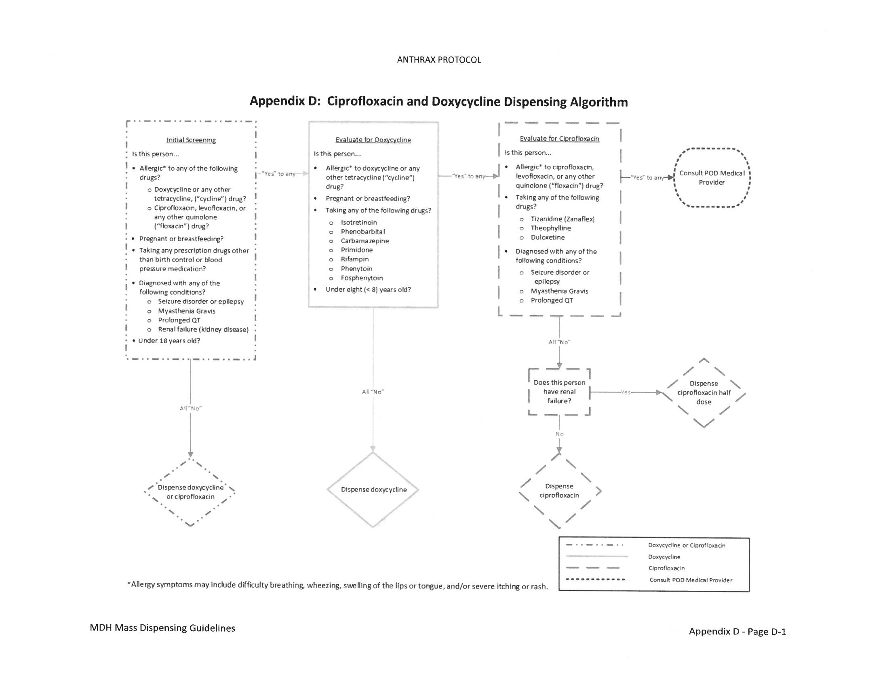
Screening Algorithm
Notes:
There is an algorithm to apply to the screening form. It looks for very specific contraindications and directs towards which medication is most appropriate for the client.
There is a section for medical consult when it doesn’t quite fit anywhere on the algorithm.

Slide 40
Medical Consult Tasks
Discussion with medical professional
within the CPOD or via phone
Does NOT mean the client is unable to receive an MCM
May dictate changes in current
prescriptions, modifying dosage or monitoring for reactions
May result in client being sent to a clinic for further evaluation
Additional Medical
Consult Required
Notes:
People who can’t take doxycycline or ciprofloxacin or have specific medical considerations need a medical consult. Because of potential contraindications, these individuals must further consult with appropriate medical personnel to determine the best course of action. Your CPOD may have access to their own medical consult (especially if your are a hospital), otherwise LPH will ensure that you have access to a medical consultant during CPOD operational times. This might be a phone visit, so we need to make sure phone service is available.
Being sent to receive additional medical consultation does not always mean the client cannot receive the medication. It may mean that the client must stop taking a current medication before taking the medication dispensed at the CPOD. It could also mean that the client should take a modified dosage of medication and monitor for any signs of a reaction or worsening condition.

Slide 41
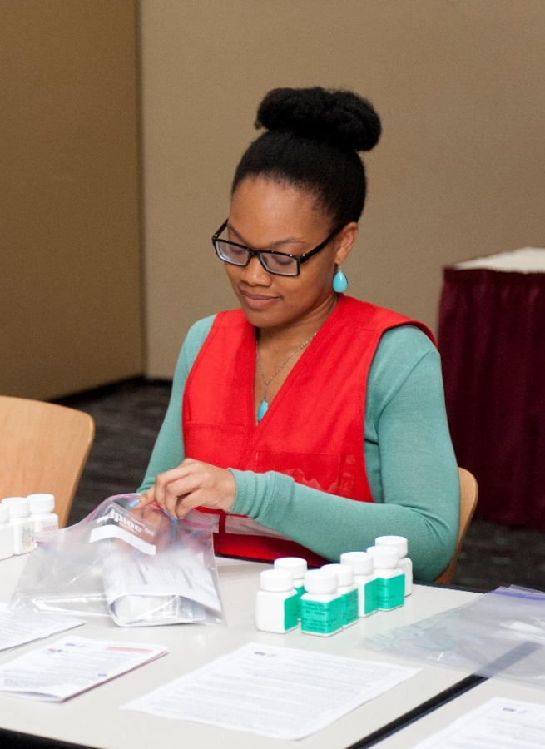
Dispensing Tasks
Ready the MCM identified by the screener on the screening form
Verify clients know which MCM the person receives
Label all medications and provide fact sheets
Ask if clients have any additional questions
Direct client to Education or Exit Usher
Notes:
Finally the person is ready to receive their pills. The dispenser labels the correct bottle, provides medication fact sheets and sees if there are any questions. Tell the person that if they have any questions about the medication to contact their health care provider. Information about how to report adverse reactions is written on the education sheets.
Fact sheets and label templates will be provided, but your CPOD may need to make copies of these. You can see how two people may want to work together to do screening and dispensing.

Slide 42
Education and Exit Usher Tasks
Answer any other questions
Remind people to contact their health care provider if they have questions
Know how to report at adverse event
Encourage people to take the first dose as soon as possible
Direct clients to the exit
Notes:
The education staff person you will answer questions using the fact sheets for the agent, medication or how to take it instructions. There needs to information provided on when to talk to their personal health care provider for more questions. All medication and fact sheets do include how to report and adverse reaction to the medication.
The Exit Usher guides them out of the CPOD.

Slide 43
Process Flow Chart
Notes:
That is a lot to get done within a CPOD! The main goal is to help them “flow” through the process. Remember the goal is to get MCM to people quickly. This is a process flow chart to see how the functions work towards that goal. The persons working those functions may have specific station. How the CPOD is set up will dictate the actual course people will follow. It’s important to look at the space where the CPOD is held. Identify ways to quickly pass clients through, areas where you will provide added assistance, staff support, inventory, etc. Adjust the flow of people or stations as needed during CPOD operations to help the flow of clients and reduce the stress of staff.

Slide 44
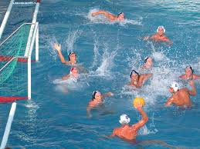

CPOD Flow Evaluation
Do a walk through of the CPOD space
Identify where each function will take place
Locate areas for staff and inventory
Consider clients needing extra support
Notes:
Assessing CPOD flow is a great way to exercise your CPOD plan and train staff. Evaluate your CPOD area and see where you would place the different functions. Take into consideration the room, what is needed to support the CPOD logistically, how people will enter and leave. You can have staff walk through to receive “fake” MCM to see how things go. Another way to do this is if your organization does yearly staff events, like flu shots, where staff get together.
By doing some walk throughs and involving staff, you can also identify staff who would perform well at the different functions.
The goal is to makes sure the CPOD isn’t like a water polo match, but more like swim lanes.

Slide 45
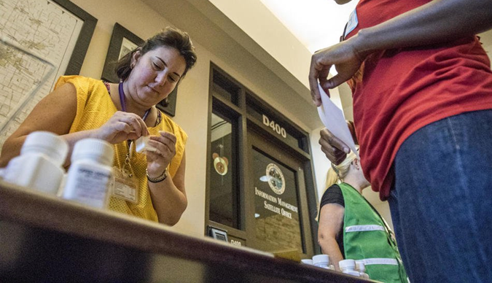
CPOD Function Conclusion
CPODs have specific functions and tasks
Job Action Sheets/Guides help identify specifics for that role
Goal is to get the right MCM to people quickly
Flow looks at how smoothly the CPOD is operating
Adjust CPOD flow as needed
Notes:
The functions in a POD are designed to accomplish the goal of a POD – MCM into people quickly. Altering the flow may assist in smoother operations.

Slide 46
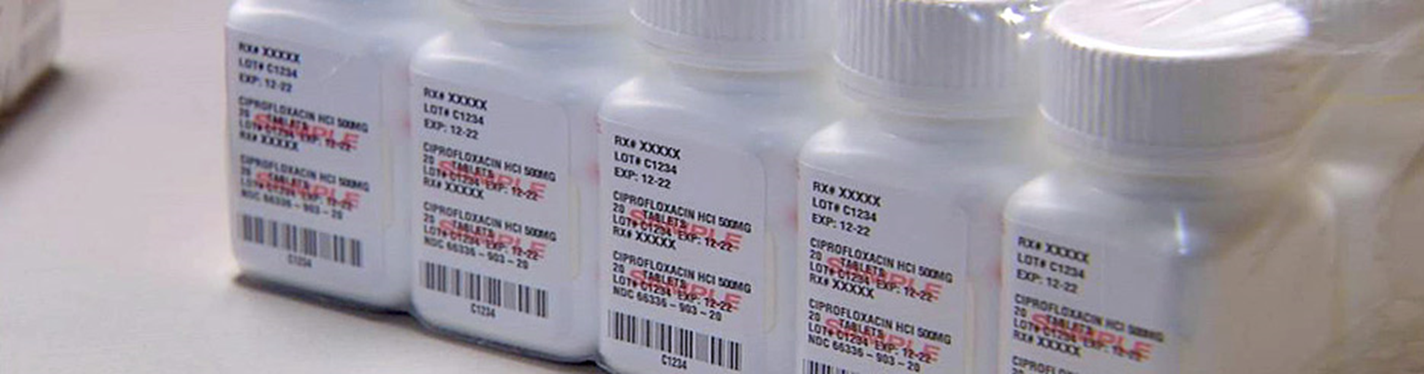
CPOD Summary
CPODs get MCM to people quickly during a public health emergency
CPOD allow organizations to dispense to their specific population
CPOD functions ensure the right MCM goes to the person
Local Public Health agencies are here to support POD and CPOD partners
Notes:
There has been lots of information given today. In summary, PODs are a critical piece of a MCM response to a public health emergency. We hope that by learning about CPODs, you can identify the value in becoming a CPOD partner. Local public health is willing to work with you for planning, exercising and ongoing needs.
Thank you for your time. Questions?

Slide 47

Thank you!
Public Health will be in close contact with you throughout the CPOD process
Contact your Local Public Health person for more information
Notes:
LPH sees CPODs as reciprocal. You are helping us out by taking some of the general population away from the open PODs. Thus, we want to help you succeed in being an efficient CPOD. We’ll be in close contact to provide you with the most up to date information, protocols and items needed.
Any further questions?

