Slide 1


Closed Points of Dispensing (CPOD)
Benefits for West Central Healthcare Coalition Partners
Emergency Preparedness and Response

Slide 2
Topics
Mass dispensing: PODs
CPOD partners
CPOD benefits
CPOD function
Legal background
Dispensing guidelines
Planning tools
Receiving assets
How to become a CPOD

Slide 3

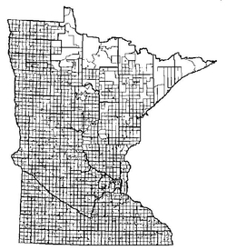

Mass Dispensing and PODs
open POD
closed POD
Notes:
Mass Dispensing/Medical Counter Measure Dispensing is providing medication to large numbers of people who may or may not have been exposed to a disease or toxic agent. Lets take the example of weaponized Anthrax released into the air. Because this form is so effective, a huge part of the population has potentially been exposed. In this case, Local Public Health is going to facilitate the opening of, and staff, open Points of Dispensing, where the general public- anyone and everybody –are going to travel to and receive their Post Exposure Prophylaxis of antibiotics. Unless you are sick, which means you are going to hospital to receive your medicine. (Anthrax we would need to reach entire affected population within 48 hours). Hard for LPH to staff alone.
Its not to hard to imagine that given the size of that group of people that need medication that these open PODs may be become overwhelming for staff and public involved. That’s where closed PODs come in into play.

Slide 4
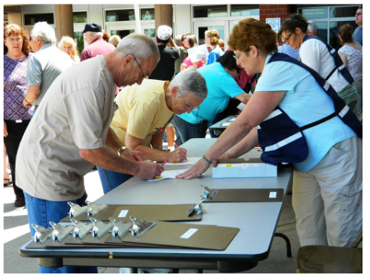
Closed Point of Dispensing (CPOD)
Potential CPOD partners:
Hospitals and healthcare entities
First responders
Private business
Governmental organizations
Notes:
We are looking at this group of potential closed POD partners to work with public health to help take care of our communities.
We recognize that these are entities who need their staff on site to respond to the incident
You will need to designate staff and staff time for your planning efforts.
Training staff will help your organization be successful in distributing medications. You may be asked to participate in periodic exercises with public health.

Slide 5
CPOD Benefits
Care of your staff and their families
Continuity of Operations (COOP)
Care of clientele
Assist in overall response
No cost
Increase general emergency preparedness for agency
Notes:
By virtue of being a CPOD partner you are able to ensure your staff are protected and available to respond.
There is no direct cost to becoming a Closed POD. The medications provided during an emergency are free of charge.

Slide 6
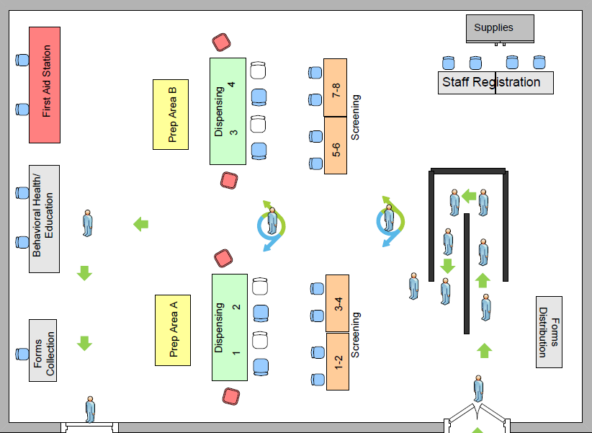
Function
Screening
Dispensing
Medial countermeasures
Specific populations,
not the general public
Notes:
Having said all this, closed PODs operate in much the same way as open PODs do. They have the same function of screening individuals to determine what medications they should receive, and then dispensing those medications to them.
Of course, a lot of planning needs to go into the mechanics and logistics of how you accomplish this task, and I will touch on a few tools to help you be successful in that regard later, but lets first take a step back and talk about legal considerations of operating a closed POD.

Slide 7
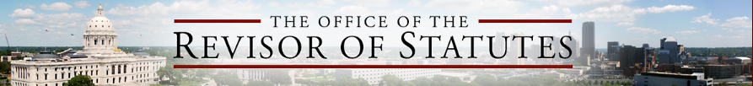
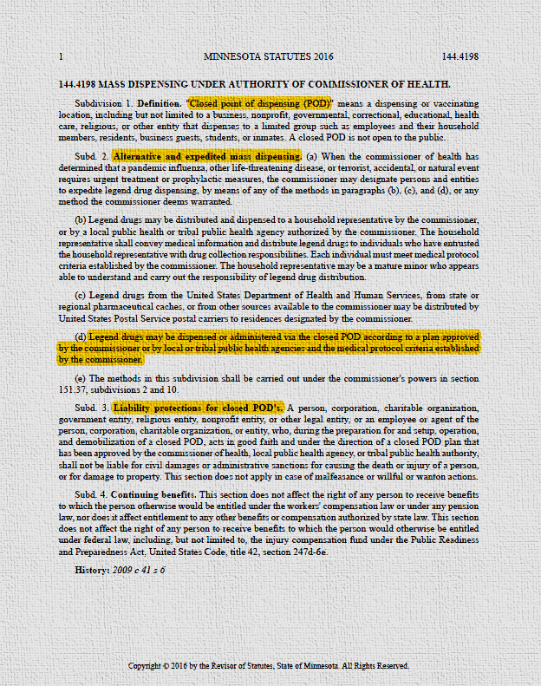
Legal Background
MN STATUTE
NATIONAL PREP ACT
MN Statute 144.4198 allows for medical countermeasures (MCMs) to be dispensed by CPODs in the state of Minnesota
https://www.revisor.mn.gov/statutes/cite/144.4198
Liability protection from tort claims (loss or harm) arising from administration and use of MCMs
https://www.health.state.mn.us/communities/ep/legal/prepact.html
Notes:
CPODs have to follow the MDH Mass Dispensing Guidelines when dispensing CDC medications or vaccines. There are legal statutes that protect you when you follow the provided guidance against adverse reactions.
Additionally the PREP Act covers CPOD staff from liability arising from administering Medical Countermeasures.

Slide 8
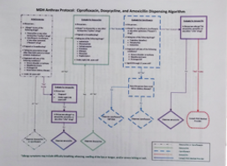
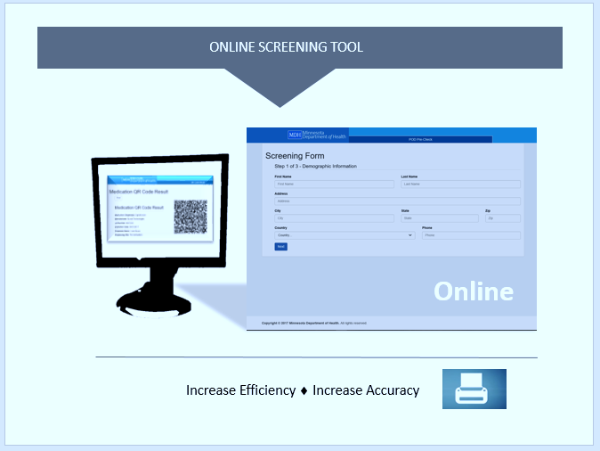
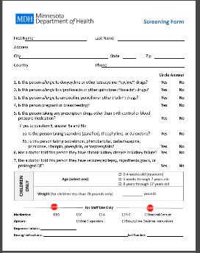
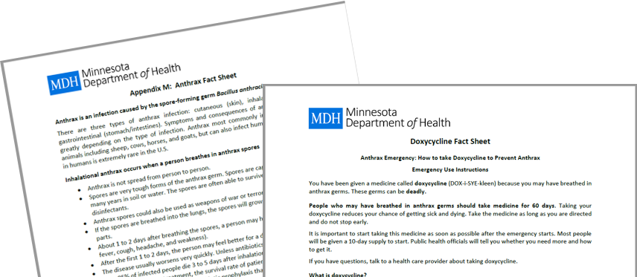
Mass Dispensing Guidelines
Closed POD
MD screening form
Dispensing algorithm
Drug information sheets
Disease information sheets
Notes:
The MDH provides a disease protocol which includes:
Screening form (either paper version or online)
Dispensing algorithm
Drug Information Sheets
Disease Information Sheets
Currently anthrax is the only disease causing agent with a statewide protocol.

Slide 9

Closed Point of Dispensing Planning Tools
Planning guidance
Enrollment form
Dispensing protocol
Forms
Site set up resources
Notes:
How do organizations become close PODs? They make an agreement with LPH, utilizing planning tools that help them organize and plan for a mass dispensing event.
Talk to your LPH for tools to use for CPOD planning.

Slide 10

Within The Planning Tools
Staffing and job positions
Communications
Receiving and managing medications or vaccines
Dispensing site: floor plan and traffic flow
Inventory management
Security considerations
Training
Demobilization
Notes:
These are some of the things the planning tools will help your organization with becoming a CPOD. These are things we want you to consider when opening and running a CPOD.

Slide 11
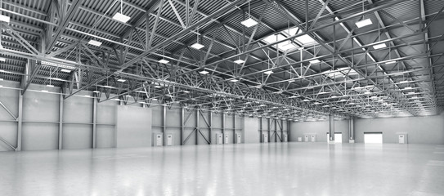
Receive Stage Store Site (SNS Assets)
Multiple locations are located statewide to have meds distributed as fast as possible!
Notes:
How will your closed PODs get their medications to dispense to their employees, members, and their families?
CPODs will be required to pick up medications from LPH. We will provide information on when, where, and how to pick up the medications and any other assets provided from CDC
Your CPOD will work with LPH to make sure you have enough supply to make it through the event.

Slide 12

I want to be a Closed POD
Partner. Who do I talk to?
I want to be a Closed POD
Partner. Who do I talk to?
Notes:
Finally, you might be asking yourself: who do I talk to if I want my organization to be a CPOD?
Reference documents – Healthcare Coalition Website (FAQ, plan template, etc)
Talk to LPH and let them know you would like your agency to be a CPOD
Work with LPH to complete forms
TA-DA you are a CPOD!

Slide 13

How do we become a Closed POD Partner?
Complete the Closed POD Enrollment Form & Closed POD Plan
Communicate the plan with staff
Practice the plan
Share updated contact information with local public health
Notes:
Most of the plan can be completed at the meeting
Practice the plan (communication drills, plan activation drills/exercises)

Slide 14
Closed Points of Dispensing
Questions?

