Slide 1
Access and Functional Needs – Part 3
Five part series based upon the FEMA Integrating Access and Functional Needs into Emergency Planning – E/L0197 Course material

Slide 2
Welcome
The most important concept for emergency planners is inclusion and integration. Specifically, emergency managers must include people with disabilities in developing, writing, testing, and evaluating all emergency plans to ensure plans include the entire community.

Slide 3
Objectives
Identify appropriate resources to assist in planning for, and with, adults and children with disabilities and access and functional needs related to:
Sheltering
Support Services

Slide 4
Goals
Today we will focus on:
Physical access
General population vs medical shelter
Support services
Communication access
Programmatic access
Recovery

Slide 5
Identifying Shelter Sites/Facilities
Federal law states children and adults with disabilities have equal opportunity and access to emergency programs and services.
Assumptions are that if a building is designated as a shelter it will meet the needs of all individuals as long as it provides a safe place to eat, sleep, and take care of personal hygiene. NOT ALL shelters are appropriate to support those with access and functional needs….MODIFICATIONS may be needed.
http://www.ada.gov/pcatoolkitchap7shelterchk.htm
Notes:
Consider formal agreements with people with disabilities or disability advocacy, service/support providers or other agency staff. They have the experience and expertise with the requirements of those with AFN.
It is critical to have quick access to the resources needed to set up a shelter – those preexisting agreements will help with that.

Slide 6
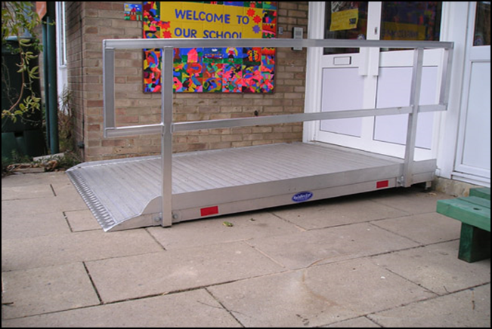
Accessibility
Entrances
Access Routes
Showers
Feeding
Notes:
Entrances – include areas to drop off (loading zones) and an accessible path to the shelter entrance.
Posted signage to show the accessible entrances, rest rooms, food, telephones etc. Signage must be able to be understood for those with language barriers/visual barriers etc.
Need to consider wheelchairs, crutches, walkers when planning for access to all services (showers, bathrooms, feeding areas etc)
Consider pre-planning – contracts with companies that provide the specialized accessibility options (porta-potties that are accessible, showers that are accessible).

Slide 7
Lets look at these options……….
What is wrong with these photos?
Are they providing services/resources for those with AFN?
Are they restricting access?
What needs to be done?

Slide 8
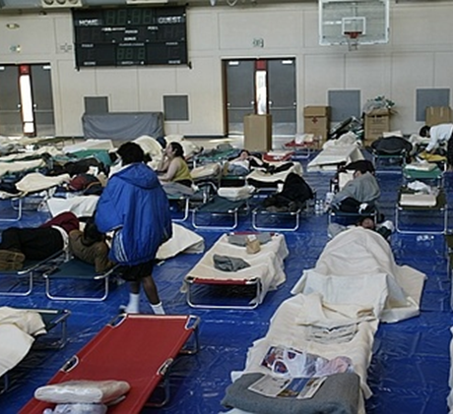
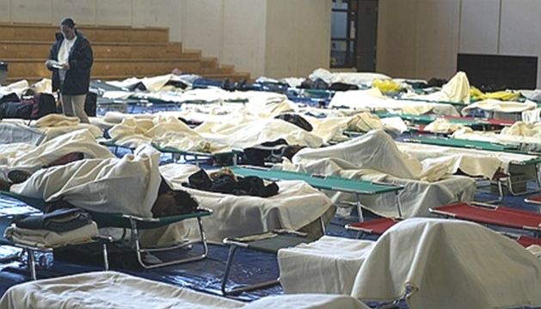
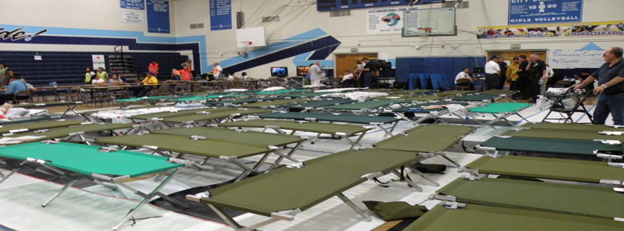
Notes:
Is this accessible?
What to do?
Offer to locate residents with mobility limitations near unobstructed areas and accessible routes where they can easily get to bathrooms, dining areas and exits.
Sometimes access is hard to control. People like to nest. Shelter personnel need to keep aisles accessible at all times.

Slide 9
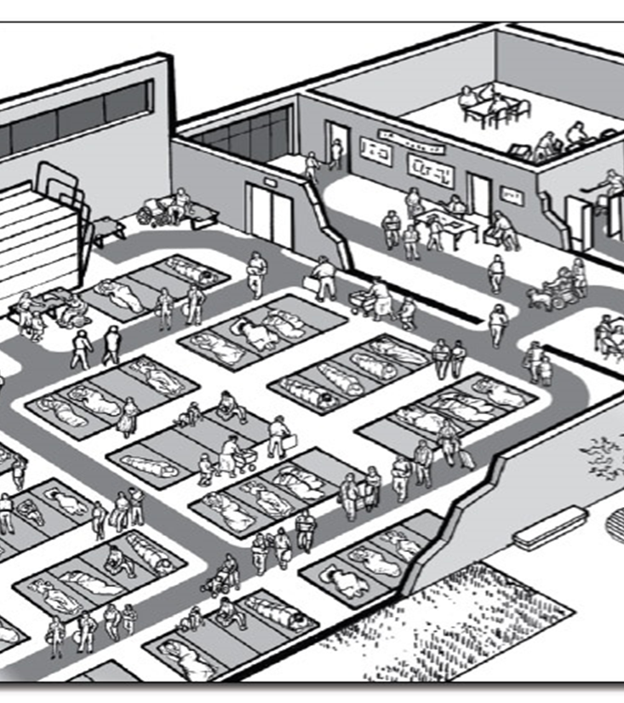
Need access routes in shelters. Shelter personnel need to in set up process. This avoids inaccessible areas for people with disabilities and others with access and functional needs.

Slide 10
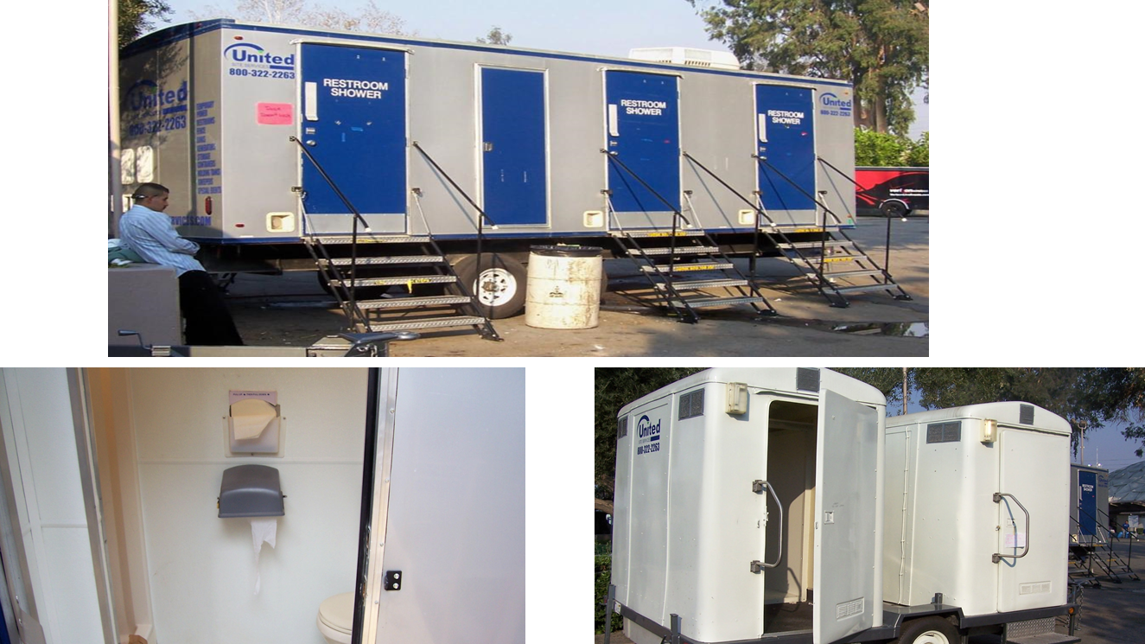
Notes:
Possible answers
No access
What would you do?
Ask vendor for accessible portable units
If none available, seek help from volunteers, carpenters, churches

Slide 11
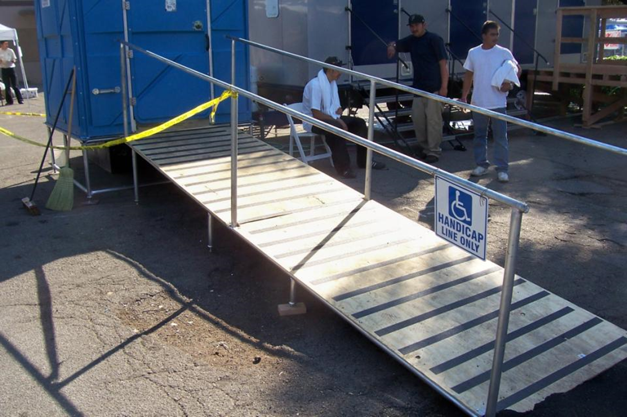
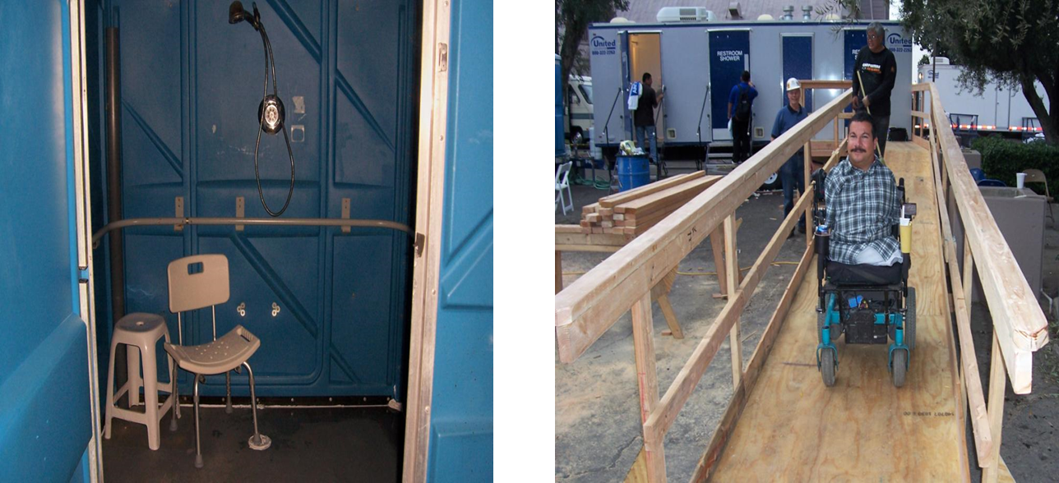
Notes:
Creative, flexible, simple fixes can help improve access to restrooms and other shelter areas.
If accessible portables are not in the plan, they won’t get delivered.
How many contracts are delivering same product?
What percentage of inventory is available and accessible?
Ratio is usually 1-6 stalls = 1 accessible stall

Slide 12
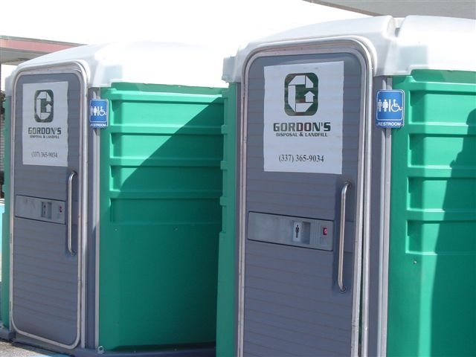
Notes:
Remember accessible shower and toilet portables.

Slide 13
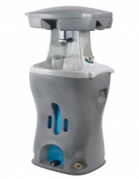
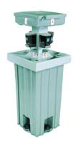
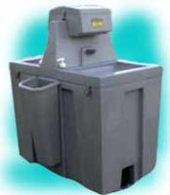
Problem?
Notes:
What is wrong with this picture & what would you do?
What is wrong?
The latest innovations in portable hand washing allows some people better access.
What to do?
Make sure to obtain accessible portables

Slide 14
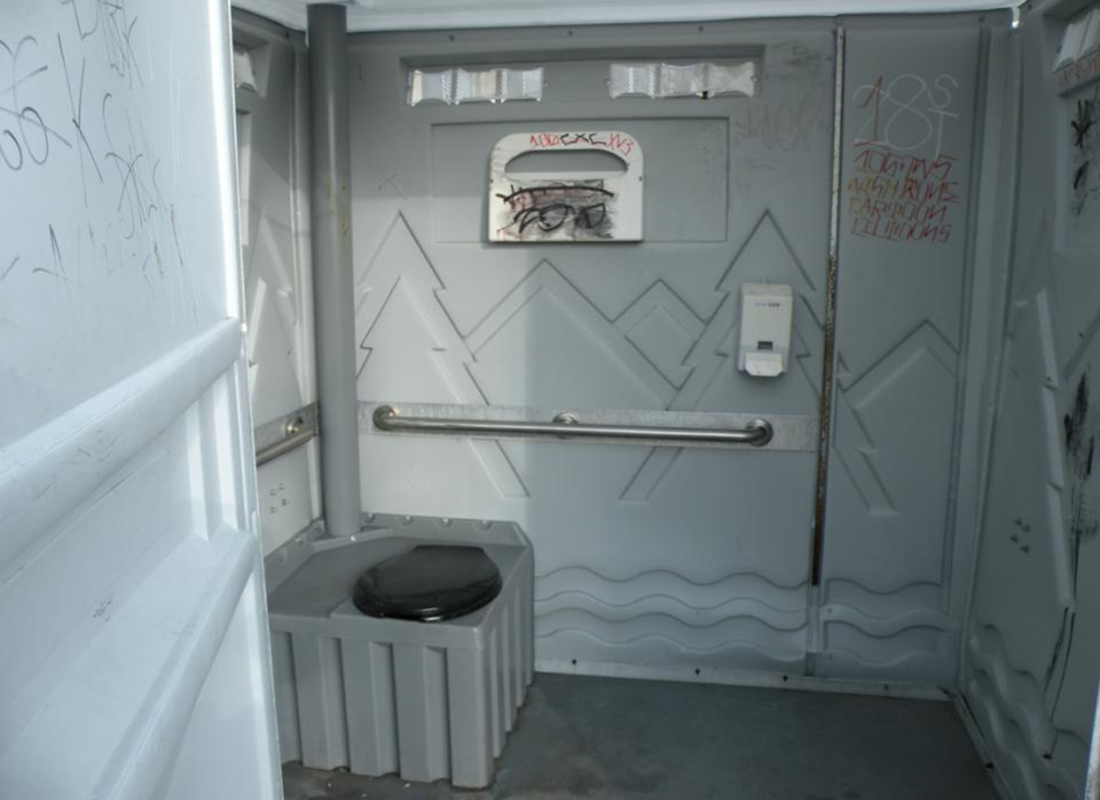
Notes:
Options – lower hand sanitizer, larger spaces, transfer/hand bars…..anything wrong? How about how high up the toilet seat protectors are?

Slide 15
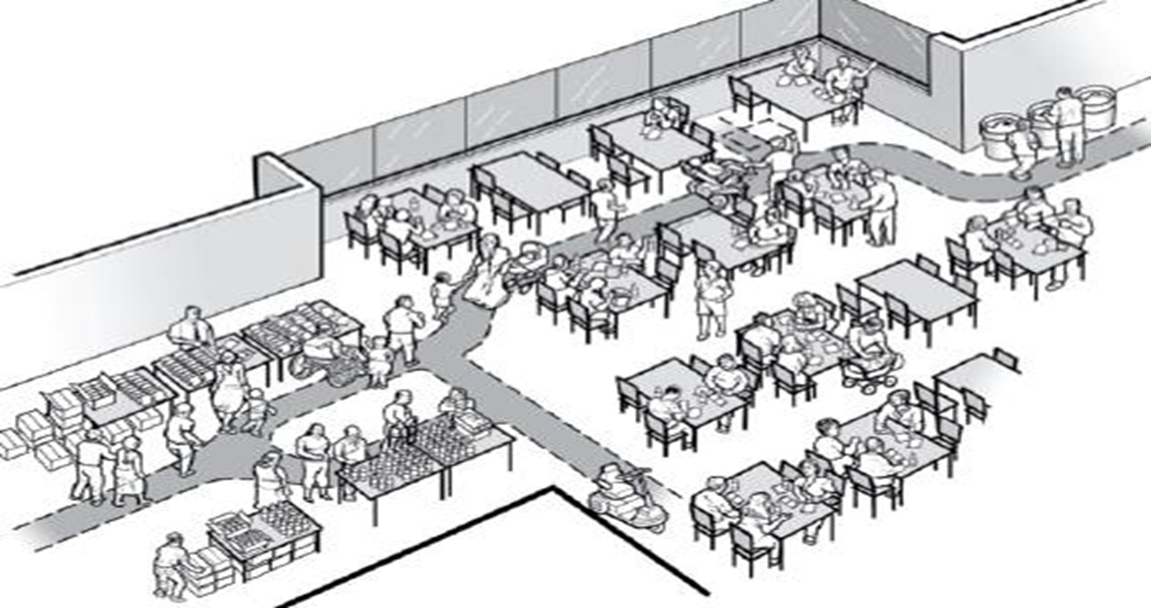
Feeding area set up
Notes:
Modify kitchen and food access policies for people with dietary restrictions and access to food.
Make sure feeding areas are accessible.

Slide 16
General population vs medical shelter
It is a mistake and inaccurate to view most people with disabilities as needing medical assistance.
Medical resources should be reserved for those with acute medical needs.
The belief that people with disabilities need medical care overburdens scarce emergency medical resources.

Slide 17
Those who do not have support from family or others may need assistance with managing acute medical needs.
If a person has an unstable, terminal, or contagious health condition, they may need to be in a medical shelter vs. a general shelter.
Notes:
Some people can handle their needs on their own or with support (tracheotomy, IV’s, managing open wounds)
People with diabetes, or on dialysis, chemotherapy, or other infusion therapies may do well in general population shelters as long as they have the ability and access to their medical needs.

Slide 18
FAST Teams
Functional
Assessment
Service
Team
FAST ROLES:
Communication
Personal assistants
Assistive equipment
Supplies
Medications
Quick access fixes
Notes:
FAST Teams are personnel that are a mix of nonprofit organization members, government agencies, service providers etc that are deployed when requested through the local EOC and stay until services are no longer needed. Assist shelter staff by assessing and helping mitigate occupants’ needs.

Slide 19
Medications:
Multiple essential medications
Supplies
Consumable medical supplies:
Medications
Catheters
Wound dressing supplies
Incontinence supplies
Oxygen
Feeding tube supplies
Durable Medical Equipment:
Regular and quad canes
Walkers and crutches
Folding white canes
Manual wheelchair
Portable ramp
Shower chair
Notes:
No matter how prepared people are, essential supplies and well stocked go kits may not be accessible to the individuals.
Shelter plans need to include:
Methods for locating/procuring and storing necessary items (agreements with providers will be essential)
Specific emergency supplies that are pre-stocked and agreements for those just in time items
MOU’s with vendors to obtain the supplies in an emergency

Slide 20
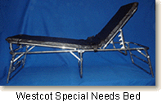
Cots
Higher and wider
Approx. 32” wide by 84” long by 18” high
Higher weight capacities
450 pounds+
Have adjustable height capability
Stability and support legs
Padding
Notes:
Standard cots don’t work for all.
Cots designed for easy transfer from a wheelchair and are easier to access for people with mobility limitations are:
Higher and wider (approximately 32" W x 84" L x 18" H).
Higher weight capacities than standard cots. (450 pounds and above)
Different types available with various features
There are no ADA cots!

Slide 21
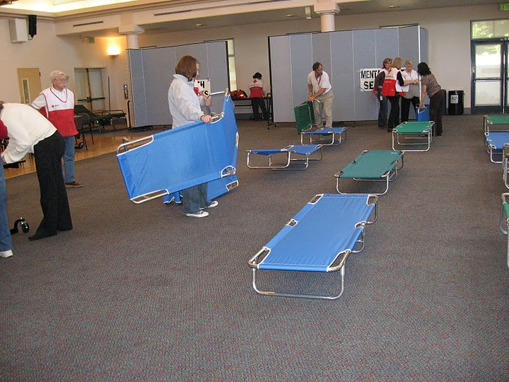
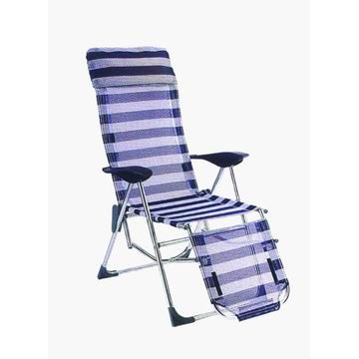
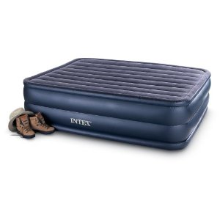
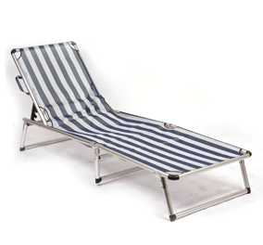
Notes:
There are several cot-type options that make transfers and sleeping easier.
We need to be creative and use viable cot alternatives.

Slide 22
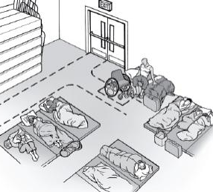
Transferring and Dressing
Sometimes cots are easier to use when one side is against a wall.
Stabilizes cot
Wall can act as a backrest
Dashed lines indicate accessible routes and clear floor space.
Consult with shelter residents with functional needs for best placement.

Slide 23
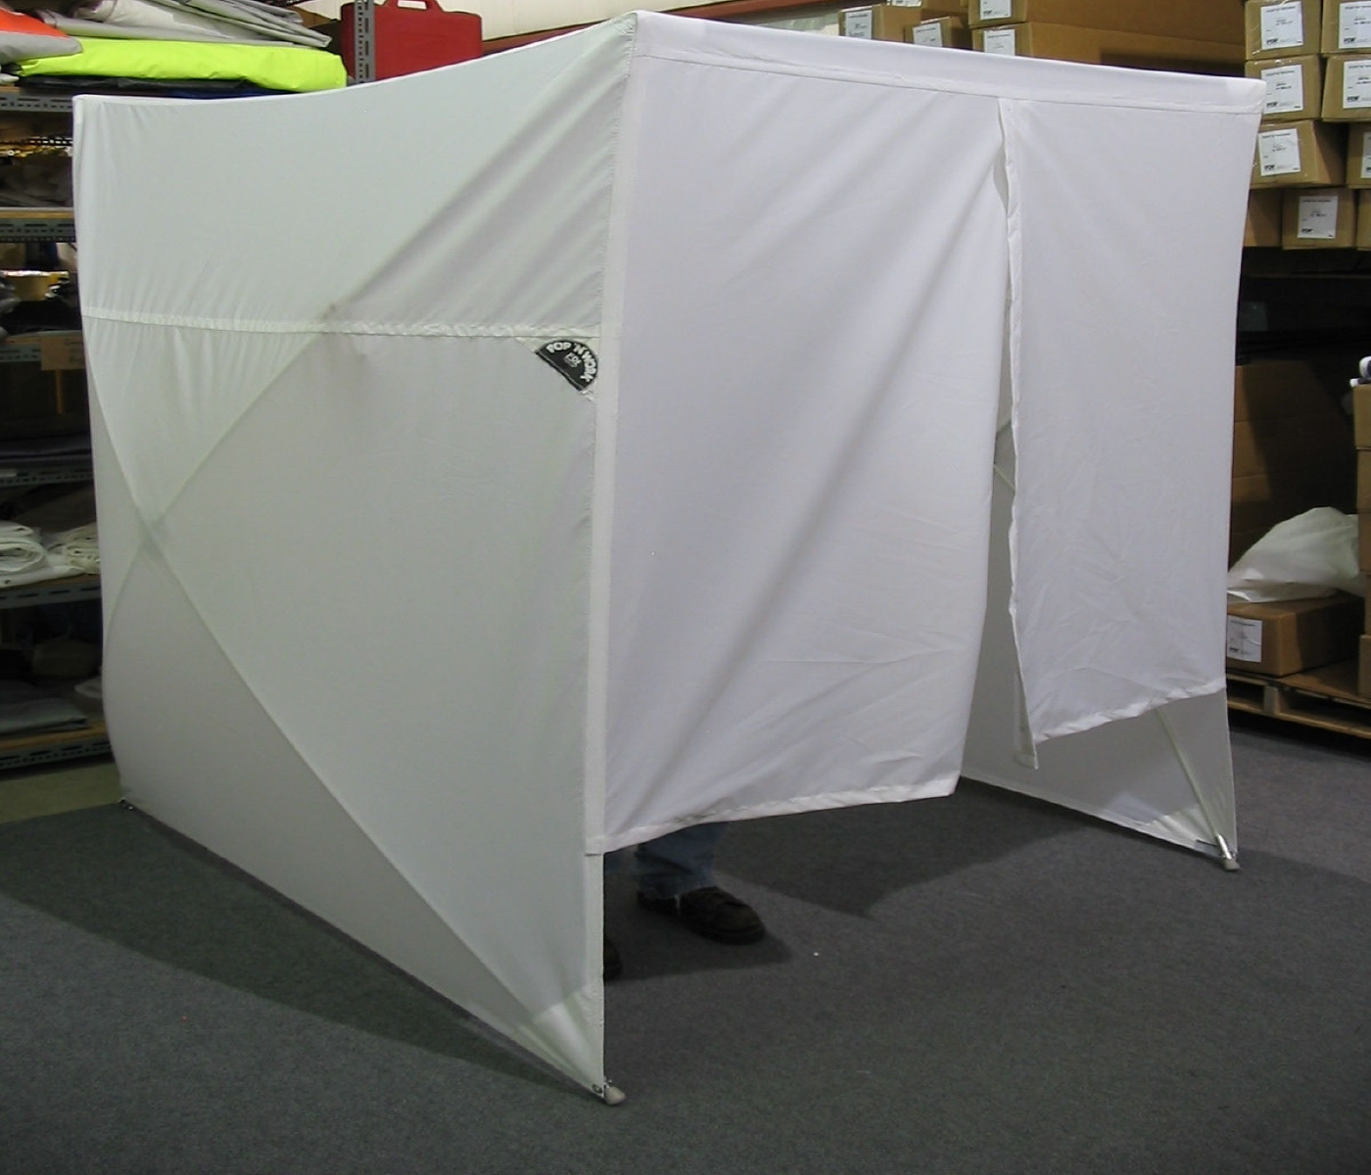
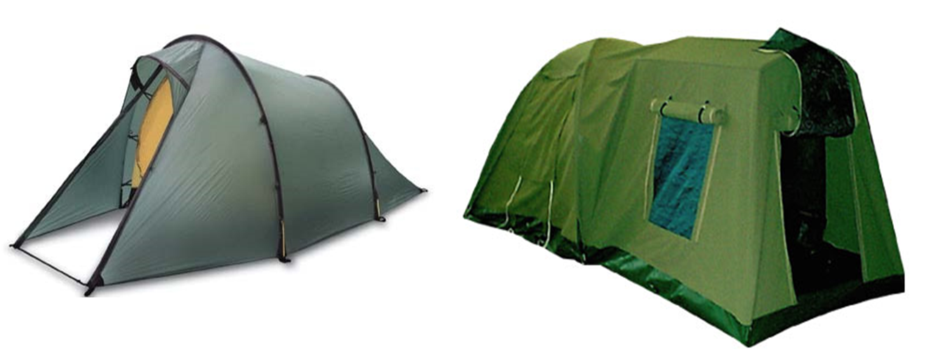
Privacy
Notes:
When possible, set up private areas for:
Personal hygiene care (catheter care and bowel/bladder care)
Breast feeding
People with asthma, chemical sensitivities, allergies, weakened immune systems (AIDS, diabetes or those undergoing chemotherapy).
Disaster assistance and social services counseling.
If private rooms are not available, create a private area using tenting, fabric, plastic sheets or other materials.
Separate areas, not necessarily private, can be helpful for
Child care and play space while residents work with recovery assistance programs.
Residents who cannot be near service or emotional support animals.
Residents who require close supervision or monitoring. This includes people with significant cognitive limitations (confusion and more advanced Alzheimer’s Disease).

Slide 24
Power Issues
Plans need to provide:
Back-up power supply if electrical services are interrupted
Access for individuals who require power to maintain or operate life-sustaining devices, motorized wheelchairs, or to preserve certain medications requiring refrigeration, such as insulin

Slide 25
SERVICE ANIMALS
Absence or presence of a service animal can mean the difference between person who needs shelter assistance and one who functions independently
Service animals must be permitted to accompany owners in shelters
ADA definition: Guide dog, signal dog, or other animal individually trained to provide assistance to an individual with a disability

Slide 26
Personal Assistance Services
Examples of support that may be needed:
Grooming
Eating
Toileting
Transferring
Completing forms
Notes:
Who can provide the services:
Personal Assistants can include but not limited to:
Family
Friends
Neighbors
Evacuees in the shelter
Home Health Aids
In-Home Supportive Services (IHSS) Providers/Personal Assistants

Slide 27
Recovery
To comply with ADA requirements and to assist people in avoiding unnecessary institutionalization, assistance may be needed to help people:
Return to their home
Locate a new home in the most integrated setting
Notes:
Navigating the Recovery Process:
Challenge for anyone
Organizations providing direct services to people with disabilities and others with access and functional needs must be integrated into all local assistance centers and disaster recovery centers.
All materials and forms must be available in alternate formats.

Slide 28
Recovery needs
Temporary and long-term accessible housing
Communication
Supplies and equipment replacement
Personal assistance services
Transportation
Applying for financial assistance
Interpretive services available throughout
Notes:
Coordinating Recovery
Use community resources
Communicate and plan with partners and government to identify gaps in services
Identify what is being coordinated and provided
Filling out forms and writing
Repair or rebuild damaged housing, including accessibility modifications

Slide 29
Mobile Recovery Services
Procedures must be in place to provide assistance with:
Reading
Understanding of materials
Filling out forms
Interpreter services available

Slide 30
Private Industry
Re-establish or access public benefits and services
Replace supplies and equipment
Identify temporary and permanent independent living options
Repair or rebuild damaged access housing elements

Slide 31
FEMA Individual Assistance
Allowable uses include:
Automatic door openers
Durable medical equipment
Modifications

Slide 32
Housing
Emergency Transportable Housing Unit
Travel trailers
Park models
Manufactured housing
Other factory-built housing
Permanent housing
Uniform Federal Accessibility Standards (UFAS) units

Slide 33
Activity: Identifying Action Items
Identify action items that you will take back to your organization.
Address sheltering and recovery elements.

Slide 34
Summary
Federal and state laws require children and adults with disabilities have equal opportunity and equal access to emergency programs and services.
Plan to help people during the recovery process to avoid institutionalization; accommodate and modify where necessary.

