Slide 1

Emergency Preparedness
Where do we start?
Shawn E Stoen
Regional Healthcare Preparedness Coordinator
Notes:
Establishing the core fundamentals to an emergency preparedness program is essential for it’s success. Often times it is the question: “where do we start” that doesn’t get answered and puts emergency preparedness back to the bottom of the totem pole. When the structure is in place, which will take some work, the maintenance of the emergency preparedness program becomes a very realistic outcome.

Slide 2
What is our reality?
All 87 Minnesota counties have been declared a federal disaster area at least once since 1965.
Healthcare facilities throughout the nation have experienced fires, floods, utility failures direct impacts by tornadoes and have had to evacuate.
You all have had incidents that could have been much worse than they were!
Notes:
Some of you may think that this will never happen to us – not at our facility or in our community. Well since 1965 every county in the state of MN has had a declared federal disaster. That is pretty significant, even though we can maybe sit here and say some of these scenarios that we are sharing with you have a slim chance of affecting you, that doesn’t mean that something won’t.

Slide 3
Who is responsible for the work?
Start at the top!
  Administrator
  Director of Nursing
  Maintenance Director
  Human Resources
  Safety Committee Members
Get creative where you can.
  Interns
  Nursing Students
  Staff on light duty
  Content Experts
Notes:
Once you have identified who is responsible for the work, then it is important to determine what work needs to be done and how it is going to get done. There has to be a process for decision making. Use what is already in place or put one in place.

Slide 4
Get the Team Together
Plan Ahead
01
Provide Information About Team Expectations
02
Get Support from Leadership
03
Flexibility
04
Consider Using External Facilitators
05

Slide 5
Emergency Preparedness Program
Emergency Plan
Policies & Procedures
Communication plan
Training and Exercises
Integrated Health systems
Emergency & Standby power

Slide 6
Emergency Operations Plan
Policies and Procedures
Communications plan
Training/Exercises
Facility HVA/Community HVA
Continuity plan

Slide 7
Hazard Vulnerability Analysis
Notes:
Starts with identifying your hazards and the level of risk associated with those risks. Keep in mind that if you don’t know your hazards and the level of risk associated with those hazards, you may not be using your energy to prepare for emergency situations as effectively or efficiently as possible.

Slide 8
What is Hazard Vulnerability Analysis?
A tool used to identify the potential risks for a facility
A prioritization process that will result in a risk assessment for “all hazards”
It is NOT a rubber stamp or just a box to be checked – it is a working document
Done annually
Notes:
Assigns a numerical value to hazards for planning, assessing and prioritizing the threats and allows the group to make informed decisions versus just creating a checklist
Is not all-inclusive however it provides a visual snapshot of issues – it is important that this document not be put on the shelf once completed – it needs to be reviewed and updated
It is a tool that can be used to demonstrate to management the risks and the level that the facility is prepared
Identifies gaps in planning and provides an area to focus on - provides the Long Term Care Steering Committee with the direction it needs to help plan for education and training initiatives over the coming year.

Slide 9

Why do we need a HVA?
Because Centers for Medicare and Medicaid Services says so!!!
It will identify areas most at risk and allow facilities to focus their preparedness planning on those risks

Slide 10

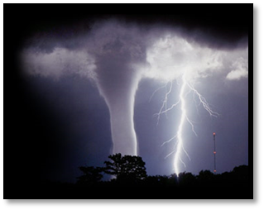
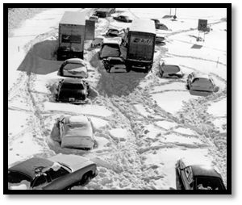
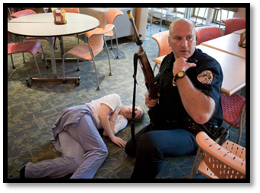
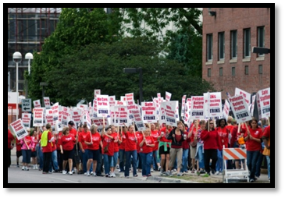
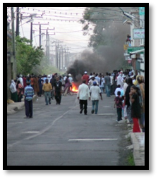
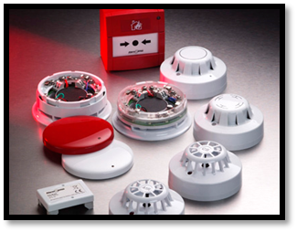
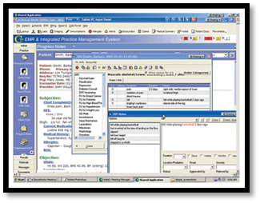
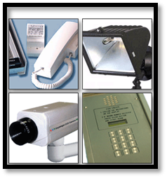
TYPES OF EMERGENCIES/INCIDENTS
NATURAL
HUMAN
TECHNOLOGICAL
Notes:
Emergency events are typically grouped into three categories.
Natural:
These are events out of our control that are a result of nature. Be it a thunderstorm, tornado, flash flood or … snow storm, these events affect our facilities in a variety of ways and because of their regularity need to be addressed and prepared for appropriately.
Human:
Events of human interaction include active shooters in your facility, civil disruption and work stoppages. These events can dramatically affect your ability to receive and provide services for your clientele. Because of the human element these events can be particularly frightening for the residents of your facilities posing a very unique type of threat to the health and safety of your residents and the facility as a whole.
Technological:
With advances in technology and our increased reliance on its operability, we have developed a susceptibility to a scenario where our reliance poses a threat to the facility in down times. Imagine a total loss of communications, power, fire detection for a period of a couple hours, days or weeks. The affect this would have on a facility is tremendous and is often the most over looked.

Slide 11
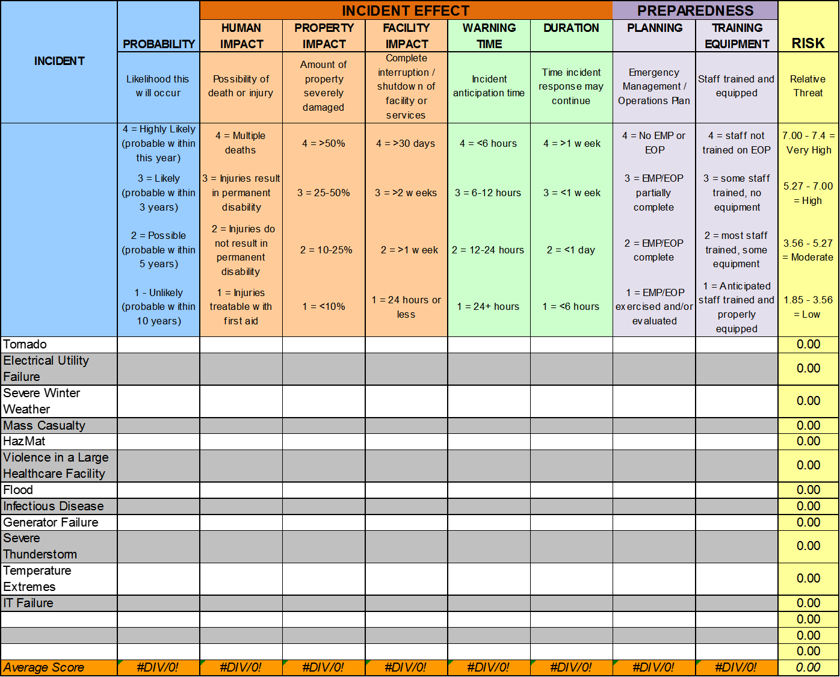
Notes:
This slide shows an example of the hand-out that you all have on your table. As you can see, the left hand side presents a list of potential hazards to your facility, and then presents the opportunity to self assess ultimately providing you with a realistic prioritization list for preparedness. Over the next few slides, we will discuss the different scoring areas and the considerations you should use in completing this tool.

Slide 12
Develop Written Procedures & Plans
Hazard specific response procedures
Communications procedures
Emergency operations plan
Business continuity plan
Notes:
How are you going to provide care to your patients?
How to share medical information/when to share and with whom to share it with
What services are you going to provide during an emergency and how to communicate that with your patients?
Evacuation procedures
Once the your hazards have been assessed, it is appropriate to identify how you will prioritize those hazards and which ones will get your attention. We can’t write protocols for every hazard and so choosing the ones that are at highest risk is pertinent. A basic emergency preparedness program will have hazard specific response procedures, such as fire, severe weather, and elopement.
The level of detail necessary for your communications plan really depends on how you format this document. There should be an element of communication and notification in every hazard specific response procedure. Those elements should include, who is being notified and how. The other communications component that needs to be considered is, once everyone is safe, who needs to be notified, how will we notify them and how frequently will we communicate with them. For example, your facility as just evacuated, you know you need to notify resident’s loved ones, where is that list, who is contacting them, how will you communicate with them. Keep this simple. This can be a stand alone document or apart of your emergency operations plan and business continuity plan.
The emergency operations plan is going to describe chain of command and emergency management strategies for consideration. Strategies may include how and where you will get more food and water when you are running low, evacuation decision parameters and how to interact with the media.
Once you feel that you have gotten the emergency preparedness program to a level of maintenance, start to incorporate business continuity planning. You are going to do some of this along the way, but start to put more focus on it. You have identified that when there is a fire, you will evacuate. Your evacuation meeting location is across the road. You have an agreement with the local bus company to come pick up your residents and you are taking them to the church a half mile away. But then what? This is where business continuity planning comes into place. Who will be responsible for finding open beds for the residents? How will they do it? Will your staff go with the residents or will they be re-assigned to other duties? Can you continue to pay your staff? How will the billing process work?
Is your head ready to explode yet? Can you imagine how your head may feel if you don’t have an idea of how all this will work during the time of disaster?

Slide 13
DO I STAY?
DO I GO?
Notes:
When writing emergency procedures keep in mind that the first decision you need to make is – will you stay or will you leave? If you decide to stay then the planning is based around sheltering in place and assuring that your facility is hardened enough to withstand most emergencies. If you or when you plan to leave, the planning will focus on getting out of the facility and continuing business in a different environment.

Slide 14
Develop an Action Plan
Determine goals and objectives
Identify the top 3-4 areas that need attention
Develop strategies to accomplish each item
Assign a time frame to each item
Assign a person to complete each item and identify the resources needed
Monitor this action plan frequently
Notes:
I like action plans. I want to know what needs to be done, who is doing and when is it going to be done by? We realize that establishing any new program can feel overwhelming. We are here to help.
Identify the top 3-4 areas that need your attention. The HVA, writing protocols for the top 2 hazards and testing them. It may be that simple – then get to work on them. Monitor them. If you can handle working on more items that 3-4, go for it.

Slide 15

Build Relationships
Create contact lists
Know your neighbors
Develop relationships with
  Emergency Manager
  EMS
  Law Enforcement
  Fire
  COALITION
Notes:
Building relationships is so important. You want relationships with fire, police and emergency medical services. They are your local responders and all disasters are local. These people are the ones who will be the first to arrive and the last to leave. Another relationship that you may find to be very beneficial is with the emergency preparedness healthcare coalition. We are made up of healthcare facilities all working on emergency preparedness. These relationships will serve you well in times of crisis.
Document these relationships. Write them into your plans. CMS wants to know how you work together.

Slide 16
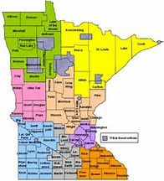
Healthcare Coalitions
Minnesota Department of Health website
  Emergency Preparedness and Response
Regional Coordinator roles
Get involved

Slide 17
COMMUNICATIONS PLAN
WHO TO CALL?
WHEN TO CALL?

Slide 18
Components of Communications
Need to maintain lists of your emergency contacts
Identify how those lists are maintained
Identify when to contact and who to contact
Staffing plan
  How are you going to communicate with them

Slide 19

Notes:
Practice, practice, practice.
Planning is so important, so I don’t want to diminish the importance of it, but sometimes we spend so much time and energy planning and discussing through what our response is going to look like that we don’t save any time or energy to practice. Determine the point that you are going to get to that says our planning is good enough for now, we can’t go any further without practicing what we have. There will be a point in the planning process that you may feel you are beating your head against a wall, that is the time to practice what you have and maybe even try a few different responses before you actually put it in writing officially.
Track/record all training and exercise participation

Slide 20
How to get buy-in?
Real event
Share hazards & risks
Practice together
Bring in local experts
Have fun
Notes:
Have you had a real event? Has an event happened a little close to home. Use these events to engage people’s interest.
Once you have completed your hazard and vulnerability assessment, share with your staff and community members the top hazards. What if your top hazard is a staffing strike – that may draw some attention.
You are going to here it over and over again, but practice, practice, practice. Practice together. It will be the talk of the facility.
Do your staff get tired of hearing your voice over and over? Bring in the police chief, the sheriff, the fire chief or the county emergency manager. They all have different voices and different perspectives. You don’t have to invite them to come and give a formal presentation, it may be as simple as asking them to observe your drill and have them provide feedback. The staff will probably remember what they say since it is a different person saying it.

Slide 21
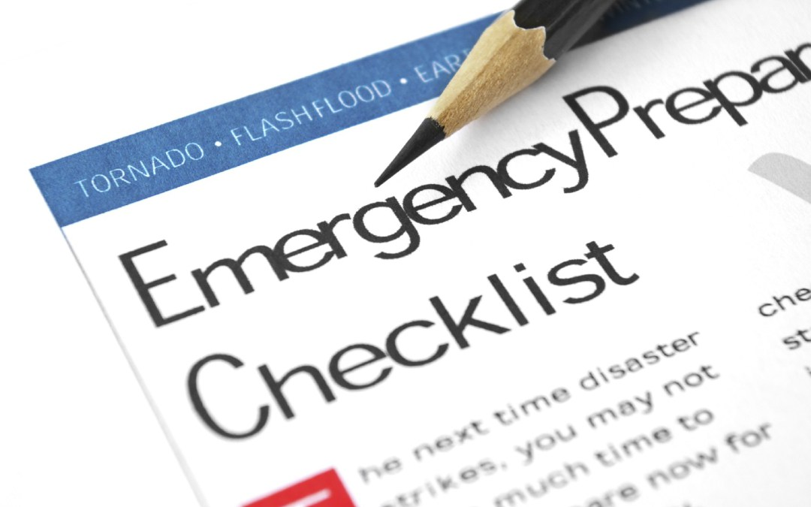
Emergency Preparedness is a Cultural Mindset
Notes:
By incorporating emergency preparedness into your organizational’ culture, your facility will be not only better prepared but also more resilient. Encouraging staff to critically think through a telephone outage or a water failure, determining what that process may look like if you had to use that process at the church you evacuated to, are ways to integrate emergency preparedness into our culture.

Slide 22
SO LETS TALK ABOUT WHAT YOU WILL DO!!

Slide 23
It is summer time, and a storm is brewing.
Your county and city is under a severe weather warning.
As you were preparing to take appropriate action, you felt and heard a loud “CRACK” of lightning.
The lighting in your facility blinked on and off.
You have residents that rely on oxygen concentrators and electricity for care?
Power is out.
Notes:
What do you do now?
What steps do you follow?
What resources would be used in this event?
Who do you call?
What about staffing?

Slide 24
Questions

