Slide 1
Basic System and Subscriber Programming Considerations
Developed and presented by
On Target Training and Consulting LLC
Contact us at 320-584-5416
Ontarget.tc@msn.com

Slide 2
System and Subscriber Programming Considerations
Table of Contents:
Definitions
Fleetmap considerations
System programming considerations
Subscriber programming considerations
Console considerations

Slide 3
System and Subscriber Programming Considerations
Before we begin, lets look at the definitions:
  Remember that most definitions and acronyms can be found on the ARMER website. ARMER
  Listed are those I recommend you should become most familiar with:
Alias | Emergency Alarm | Master Site | Roaming | Subscriber
ARMER | Emergency Call | Multi-group | Simulcast | Template
CALL Alert | Encryption ADP/DES OFB/AES | Multi-site | Site | Talkgroup
CPS | Fail-soft | Private Call | Site Trunking | Wide Ttrunking
Code Plug | Fleet map | PTT | System ID | Zone
Dynamic Regroup | ISR/ASR | Repeater | System manager

Slide 4
System and Subscriber Programming Considerations
Definitions
  Alias
  ARMER
  Call Alert
  CPS
  Code Plug
  Dynamic Regroup
  Emergency Alarm
  Emergency Call

Slide 5
System and Subscriber Programming Considerations
Definitions cont.
  Encryption
    ADP/ DES OFB/ AES
  Fail-soft
  Fleetmap
  ISR/ASR (Multicast)
  Master site
  Multi group
  Multi-site

Slide 6
System and Subscriber Programming Considerations
Definitions cont.
  Private Call
  PTT
  Repeater
  Roaming
  Simulcast
  Site
  Site Trunking

Slide 7
System and Subscriber Programming Considerations
Definitions cont.
  System ID
  System Manager
  Subscriber
  Template
  Talkgroup
  Wide Trunking
  Zone

Slide 8
Fleet Mapping Basics
Understand the basic codeplug building process
Understand preparation steps required to develop a codeplug
Understand available tools
Know where information resides to assist with building of the codeplug

Slide 9
Fleet Mapping Basics
Why is a Fleetmap Important?
Allows customized choices
Provides unique insight on trunking system operations
Encourages interoperability planning among local, regional, and state users
Gain intricate knowledge of how P25 products work

Slide 10
Fleet Mapping Basics
Information requirements
System Key (s) containing Trunked System ID numbers Trunked Control Channel Frequency List
  ARMER Trunked System ID = 740F
  ARMER WACN ID = BEE07
Conventional Frequencies with Alias’ list
Talkgroup/Announcement Group list with names and ID numbers
List of Radio ID numbers cross-referenced to radio names (alias’)
Talkgroup fail-soft frequency plan

Slide 11
Fleetmap Development Technical Skills
Understand P25 trunked system operational modes
  Wide Area – Simulcast and ASR roaming
  Site trunking
  Fail-soft
Knowledge of subscriber features
  Understand subtle differences between portable and mobile subscribers

Slide 12
Fleetmap Developer Technical Skills
Knowledge of Motorola console products
  MCC 7500
  Gold Elite
User Configuration Management (UCM)
development rules
Microsoft Excel or Access knowledge
Knowledge of Customer Programming Software (CPS)

Slide 13
Fleetmap Process Phases
Preparatory Documentation
Fleet
Education
Ongoing
User Consultation
Subscriber & Console Template Build
CPS
Codeplug Test
Mass Programming
We should review the ARMER Standards, specifically SECTION 2

Slide 14
Fleetmap Process Phases
Preparatory Documentation
Customer Education
Ongoing Consultation
Subscriber & Console Template Build
CPS Codeplug Test
Mass Programming
Subscriber Template forms
TG Records form
Prepare milestones
Download seed code plugs from subscribers
Secure System Key(s)
Notes:
Show TDR form

Slide 15

System Key
What is it?
  Computer file containing the customer’s trunked system ID number
  OR
  Advanced System Key (ASK)
Notes:
Show Sys Key file!

Slide 16
Fleetmap Process Phases
Preparatory Documentation
Fleet
Education
Ongoing Consultation
Subscriber & Console Template Build
CPS Codeplug Test
Mass Programming
Trunking system modes
TG operations
Subscriber features and operations
Console features
Fleetmap data forms introduction

Slide 17
Fleetmap Process Phases
Preparatory Documentation
Customer Education
Ongoing Consultation
Subscriber & Console Template Build
CPS Codeplug Test
Mass Programming
Continue technical assistance to fleet
Compile templates
UCM record development for System Manager
Enter TG & Subscriber information into UCM

Slide 18
Fleetmap Process Phases
Preparatory Documentation
Customer Education
Ongoing Consultation
Subscriber & Console Template Build
CPS Codeplug Test
Mass Programming
Critique/correct Excel templates
Create trunk system information in seed code plugs
Create Master agency code plugs
Codeplug build review

Slide 19
Fleetmap Process Phases
Preparatory Documentation
Customer Education
Ongoing Consultation
Subscriber & Console Template Build
CPS Codeplug Test
Mass Programming
Codeplug tests on live system
Final codeplug corrections made
Create all required code plugs from Masters

Slide 20
Fleetmap Process Phases
Preparatory Documentation
Customer Education
Ongoing Consultation
Subscriber & Console Template Build
CPS Codeplug Test
Mass Programming
Transfer subscriber data forms to contractor
Transfer code plugs to contractor
Begin codeplug deployment
Inventory Control

Slide 21
Some Elements of a Fleetmap
Multigroup and talkgroup Syntax
Multigroup and talkgroup ID’s (Hex Code)
Simplex resources (SOA’s)
Permissions
Console considerations
Encryption Security Management

Slide 22
System Level Features That Drive Fleet maps
Talkgroup / Multigroup Profiles
  Secure assignment
  Priority levels (2-10)
  Site Access authorizations
  Emergency Validation
  Priority Monitor
  All or Fast Start mode
  Regroupable

Slide 23
Fleet Mapping Basics
Information Sources
System Keys
  MNDOT OEC
Conventional Frequencies with Aliases list
  System Owners / MNDOT OEC / ARMER
Talkgroup/Announcement list with names and ID numbers
  MNDOT OEC
Talkgroup Fail-soft Frequency Plan
  System Owners / MNDOT OEC
Radio Specific Programming Layout
  Custom programming specifics per user group

Slide 24
Subscriber Level Features That Drive Fleet maps
Emergency Alert/Call
Dynamic regrouping
Telephone interconnect
Secure operations (encryption)
Trunked scan operations
Multigroup (MG) assignments
Radio Wide configuration

Slide 25
MCC 7500 Console Level Features That Drive Fleet maps
Emergency Call processing
TG/MG Assignment Plan
MultiSelect Plan
TG Patch Plan
Console takeover priority (explain)
Operator level programming options
  Alert tones
  Paging
  Channel marker

Slide 26
Additional Fleet Map Considerations
Agency Group Definition
One code per Agency
    Assigned by MNDOT (2-character code)
    Ideal for recordkeeping and reports tracking
    Useful to reduce time doing record searches
No limit on quantity

Slide 27
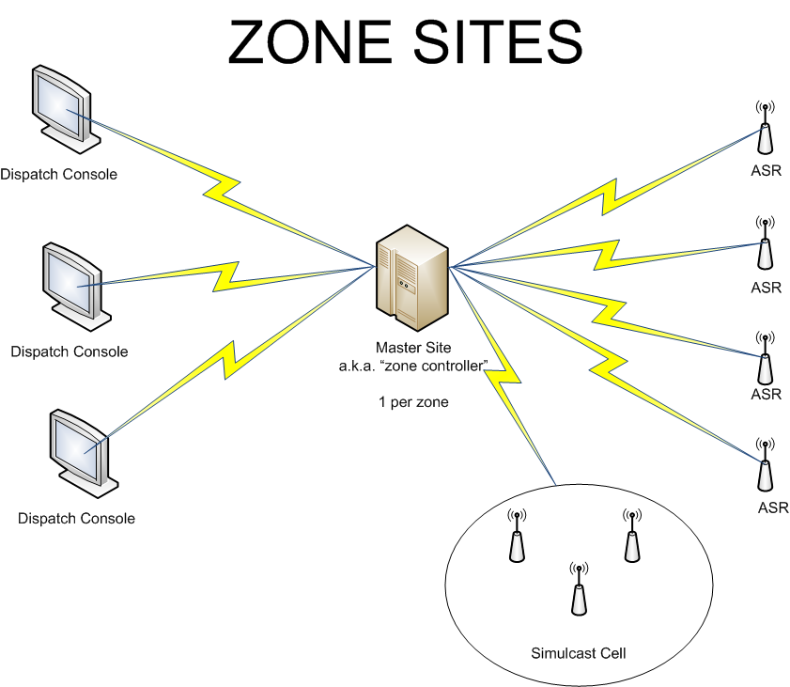
Trunking System Simplified Block Diagram

Slide 28
Trunking System Modes: Wide
Wide area
  Roaming capable (if allowed)
  Statewide access
  Multi-zone
  Multi-site
  Full system functionality

Slide 29
Trunking System Modes
Site Trunking
Site Trunking
  (Failure mode #1)
  Zone isolated
  Multi-zone not capable
  multi-site not accessible
  Subscribers are still trunking
  No “direct” contact with dispatch consoles

Slide 30
Trunking System Modes:
Fail-soft
Fail-soft
  (Failure mode #2)
  Zone isolated
  Multi-zone not capable
  Multi-site not accessible
  Revert to “shared repeater” system
  Fail-soft operation at console level
  Subscriber fail-soft programming options
    Roam, lock on repeater or roam (leave site)

Slide 31
Multigroup Definition
Members of disparate work groups are temporarily rerouted to a Supergroup via the trunking infrastructure allowing receiving users to hear priority voice messages from one initiating caller or dispatcher
  Radios and consoles capable of monitoring/ initiating multiple MGs
  Rule 1 – Each MG can support up to 255 TGs
  Rule 2 – A MG and associated TGs must be mapped within the same zone

Slide 32
Multigroup Planning
Planning Rules
  15 Talkgroups max. supported per MG
  A Talkgroup can only be associated with one MG
Secure vs. Clear (if applicable)
Wait vs. Interrupt mode
Console assignments
Define which TGs assigned to each MG
Notes:
Show Multigroup documentation sheet!

Slide 33
Talkgroup Considerations
Utilization
Naming convention
Interoperability
Layouts in subscribers
Personality/characteristics

Slide 34
Initial Talkgroup Considerations
Utilization
  What do we need it for?
  Consider true interoperability
  Consider multi-discipline utilization
    Shared “pools”

Slide 35
Initial Talkgroup Considerations
Naming Convention
  What is it’s purpose
    LAW
    FIRE
    Public Works
    Emergency Management
    Multi-discipline interop
  Consider keeping the name simple
  Consider character limitations

Slide 36
Initial Talkgroup Considerations
Interoperability
  Who, what where when why how
    CM Region examples
      Fire example of primary service area
      District 3 Sheriff’s “agreement” on resources in their county
      Grant County anticipated Zone and talkgroup layouts

Slide 37
Initial Talkgroup Considerations
Layouts in subscribers
  What zone/personality assignment, why?
    Is there a way to affiliate talk groups by zone?
      F=Fire, IC= Incident Command (all-branch), etc
      CM is CM
      County level
        “Dodge 2” or “DD 2”
        Can or should we consider each others zones? “Winona” “Houston” etc
          For All disciplines?
          Grant County anticipated Zone and talkgroup layouts

Slide 38
Additional Talkgroup Planning
100-200 assigned per agency (MNDOT)
Secure, clear, or both (if applicable)
Emergency Handling
Call Alert/Private Call/Telephone Interconnect
Encourage dialogue on interoperability
  Between internal agencies
  Between internal/external agencies
TG affiliation roaming between sites
Rule – A TG can be assigned to only one MG

Slide 39
TG/MG Records Development
Some things you Probably want to track by talkgroup:
    ID number
    Talkgroup alias
    Allowed permission of use
    Talkgroup profile
      Capabilities and characteristics
        Fast start or all start
        In the Console?
        Logged?
        Site Access
        Regroupable
        Encryption

Slide 40
Subscriber Consideration’s
Trunked Personality
Channel assignments (talkgroup layouts)
Alias list
Scan Functions
Selections and lists
Fixed or selectable
Site preference
Menu and switch assignments
Multigroup
Emergency Button
Alarm, CALL, hot mic, tactical or revert

Slide 41
Subscriber Consideration’s
Site preference by personality
  Can be by talkgroup
      Always
      Preferred
      Least
      None
The Site preference selections above effect performance of your radio’s, including in “Site trunking and Fail-soft”. A description of each setting is:

Slide 42
Subscriber Features Trunked Personality
Site Preferences
    Always
      Will stay on this site in site trunking
      Use this site as long as it is above the acceptable threshold
      Radio will use this site unless the site drops to poor.
    Preferred
      Use this site as long as it is above the acceptable threshold
        Radio will use this site unless the site drops to poor.
        Radio will leave this site if the site drops to site trunking

Slide 43
Subscriber Features Trunked Personality
Site Preferences
    Least
      Use this site as long as it is above the acceptable threshold
      Don’t use this site unless there are no other options
        Radio will only use this site if all other available sites are in the poor region or failed.
  No preference
      Recommended value for optimal system performance in all areas of system
        Radio will operate on site if it is acceptable and no other sites are always preferred or preferred.
        Treat all sites the same
        Default value

Slide 44
Subscriber Consideration’s
Site trunking
Fail-soft
Encryption
    Secure (strapped), Clear, Both
Surveillance Mode
Tones
Call List
Call Alert
Private Call
Announcement
Dynamic regroup

Slide 45
Alias Consistency Planning
Be aware of device character limitations differences
  Motorola
    XTS5000/2500 portable – 12 characters
    XTS1500 Model 1.5 portable – 8 characters
    MCC 7500 Console – 14 characters
You MUST understand importance

Slide 46
Subscriber Features Trunked Personality
There are 4 RSSI thresholds.
Excellent
    Default range is –89 to -93 dBm
  Very Good
    Default range is –93 to –97 dBm
  Good
    Default range is –97 to –101 dBm
  Acceptable
    Default range is –101 to –105 dBm
  Poor
    Default range is -105 dBm or below
    Radios need a 2 step RSSI level difference to consider switching sites

Slide 47
Subscriber Features Scan Functions
Trunked and Conventional Scan Decisions
  Maximum number of members varies by subscriber
  Priority Monitor, TG, and Conventional Scan modes
  Define Priority mode - Fixed, Selected Channel, or Operator Select

Slide 48
Subscriber Features Scan Functions
Trunked and Conventional Scan Decisions
  Define Non-Priority members
  Voice Transmit Talk mode – Selected Channel or Talkback
  Only one scan list assignable per trunked personality

Slide 49
Subscriber Features
Radio Wide Options
  Alert tones
  Home mode
  Emergency Keep Alive
  Time and Date format
  Time Out Timer value
  Out of Range indicators
  Noise suppression

Slide 50
Subscriber Features
Buttons and Switches
Controls (Buttons and Switches Decisions)
  Mechanical rotary switches
  Mechanical rocker A-B-C switch
  Three side buttons

Slide 51
Subscriber Features
Display & Menu
Display Menu (Soft Keys)
  Three keys per radio
  Trunking and conventional can have different programming choices

Slide 52
MCC 7500 Console Features
Resource Logging
  Which TGs will be recorded?
  Which conventional channels will be recorded?

Slide 53
MCC 7500 Console Features
MultiSelect and Patch
  Three MSEL folders (default)
  Three Patch folders (default)
  Console can have pre-programmed MSEL choices
  Console can have pre-programmed Patch choices

Slide 54
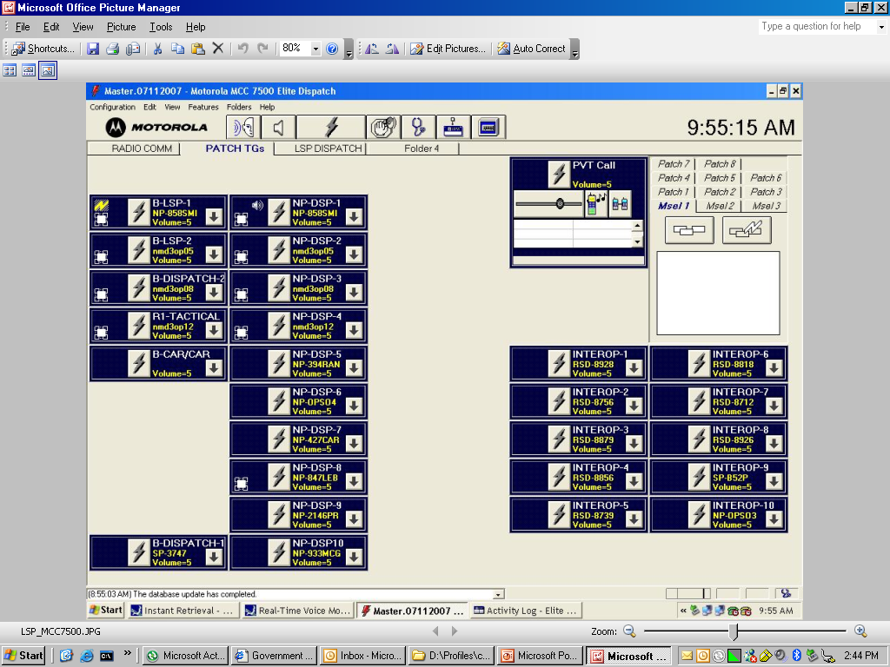
MCC 7500 Console Features

Slide 55
Thank you
Questions?
Developed and presented by
On Target Training & Consulting LLC
Contact us at 320-584-5416
Ontarget.tc@msn.com

