Slide 1
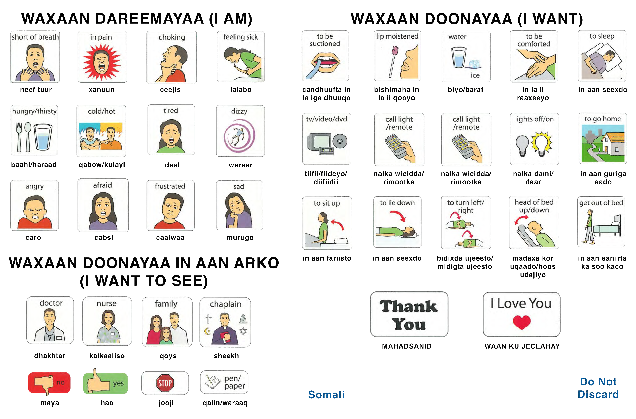


www.cwchealthcarecoalitions.org
Sawiradaan dhamaan waxaa xaq ahaan iska lch Isbititaalka Caruurta cc Boston 2015. Idan ayaa la qaatay si loo isticmaalo. Xuquuda dhamaan waa lala haray. All images copyright Boston Children’s Hospital 2015. Used by persmission. All rights reserved.
Page 14

Slide 2
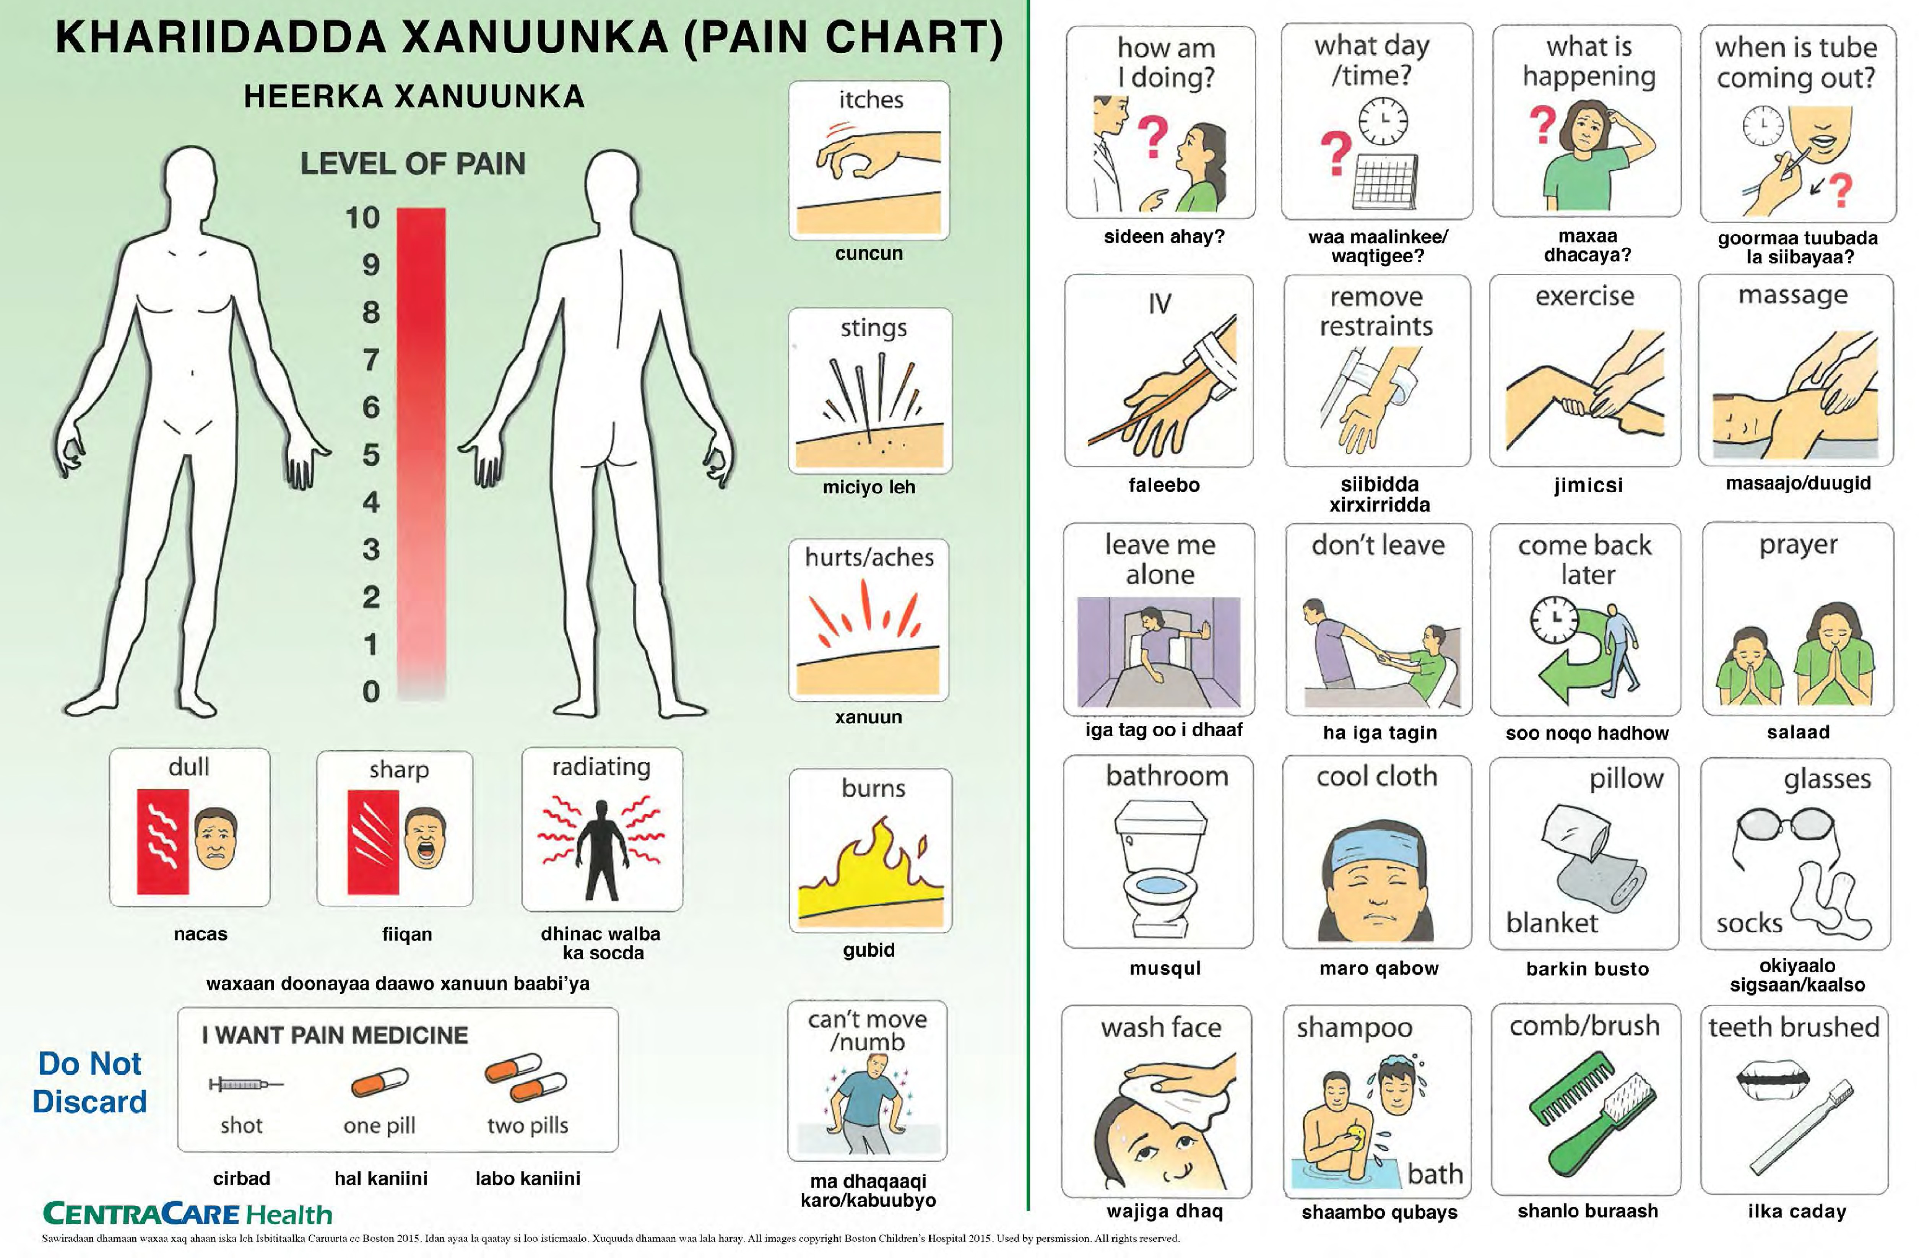
www.cwchealthcarecoalitions.org
Page 15

